Slide 1
Demo Script
Azure Web App for Containers Code Sample

Slide 2
Prepare the demo
Setup the demo according to the instructions in the README.md file in the GitHub repository.
Create or use existing GitHub AND LinkedIn accounts
Ensure that the accounts you use to run the demo have their name, company, and location populated in their profile.
If these fields are not populated then no data will be returned in certain queries in the app.
Setting up User 2
Before executing the demo you must sign in and register with User 2 and fill out their phone number and skills on the profile page.
It is strongly recommended you enter programming skills for User 2 that you will also enter for User 1.
Doing so will make User 2 show up in the Suggested Friends search result section when User 1 views it in the demo.
If you wish to use the SMS text messages, you must also follow the steps in the README file that describe how to register and verify the phone number for the user with the Twilio trial.

Slide 3
End User Scenario – Part 1
User 1 signs in with GitHub or LinkedIn account
User 1 connects GitHub or LinkedIn account
User 1 views their profile and adds additional profile info (Phone Number, Skills)
User 1 searches for friends and views suggested friends
User 1 views search results and suggested friends
User 1 views profile for one of the search result users
User 1 sends chat message to search result user

Slide 4
User 1
User 1 executes this part of the demo.
User 1 is a developer who is looking for another developer to work on a project with, or a recruiter looking to hire a developer.
Sign in with a GitHub if you are acting as a developer.
Sign in with LinkedIn if you are acting as a recruiter.
This slide deck shows User 1 acting as a developer, therefore the screens show signing in with GitHub, then connecting the LinkedIn account.
In this example, User 1 is named Code Pro Master and User 2 is named Todd Baginski

Slide 5
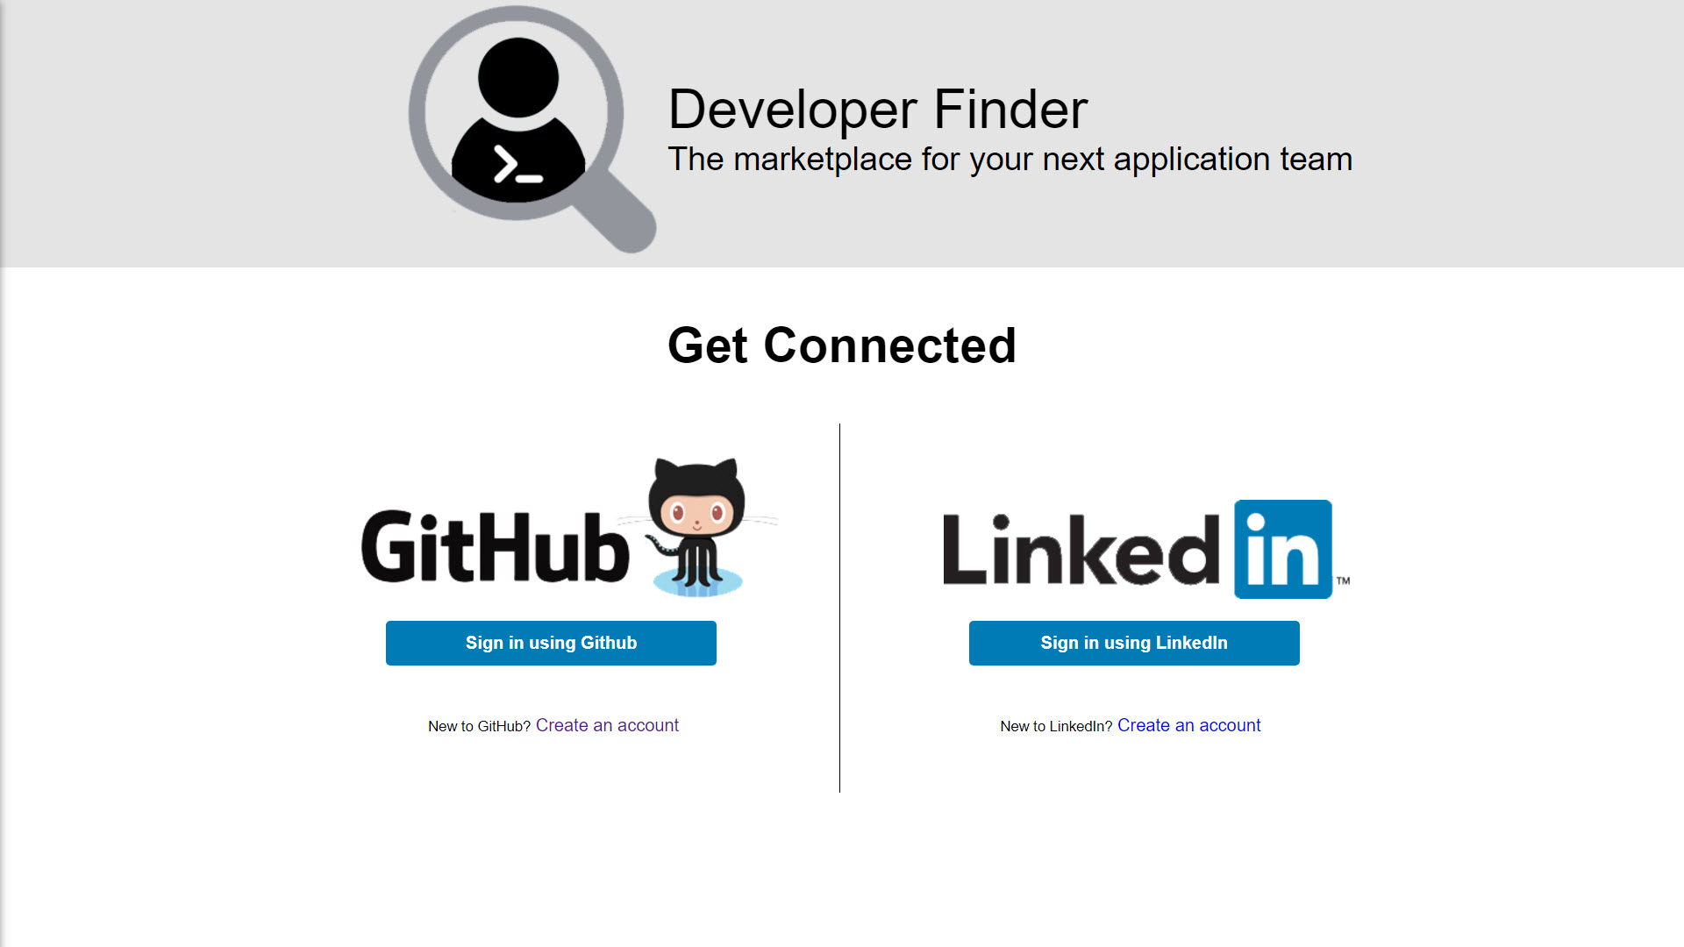
Notes:
In a web browser, open the Developer Finder Application
In the GitHub section, click Sign In using GitHub

Slide 6
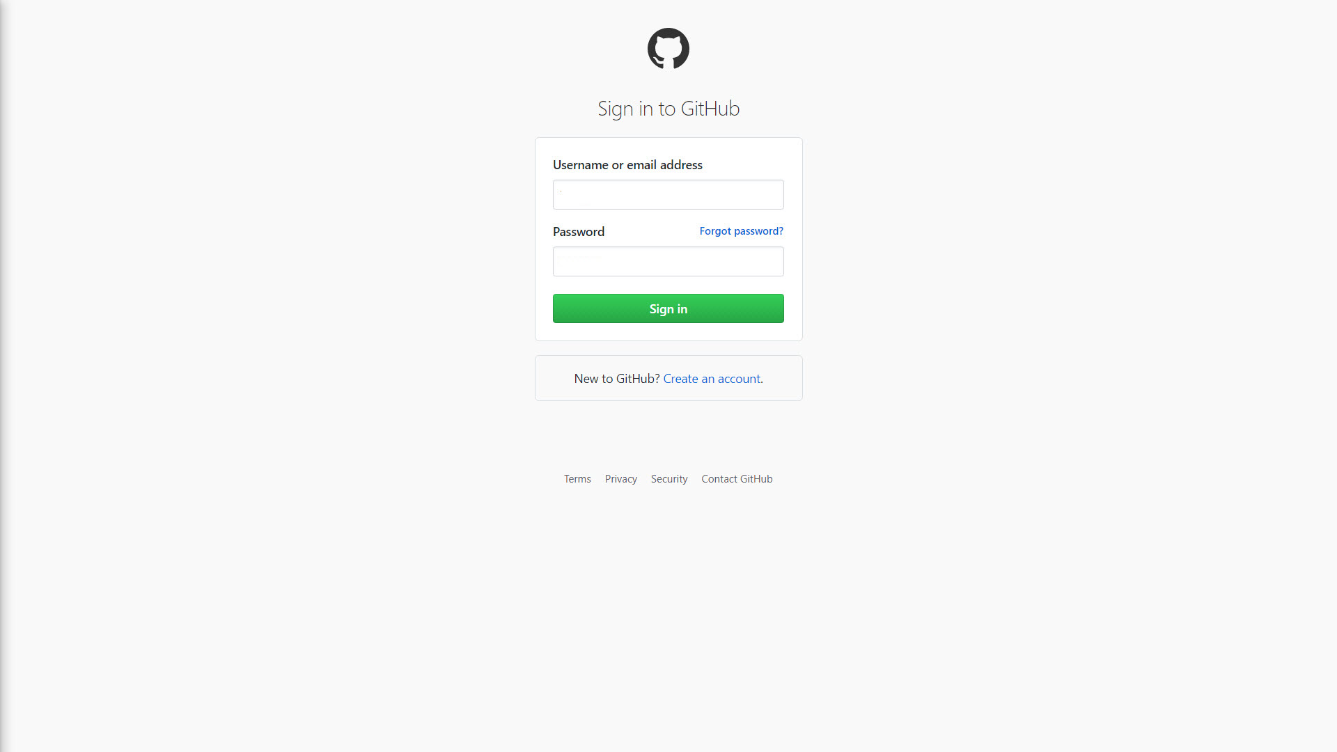
Notes:
Enter Username or email address
Enter Password
Click Sign in

Slide 7
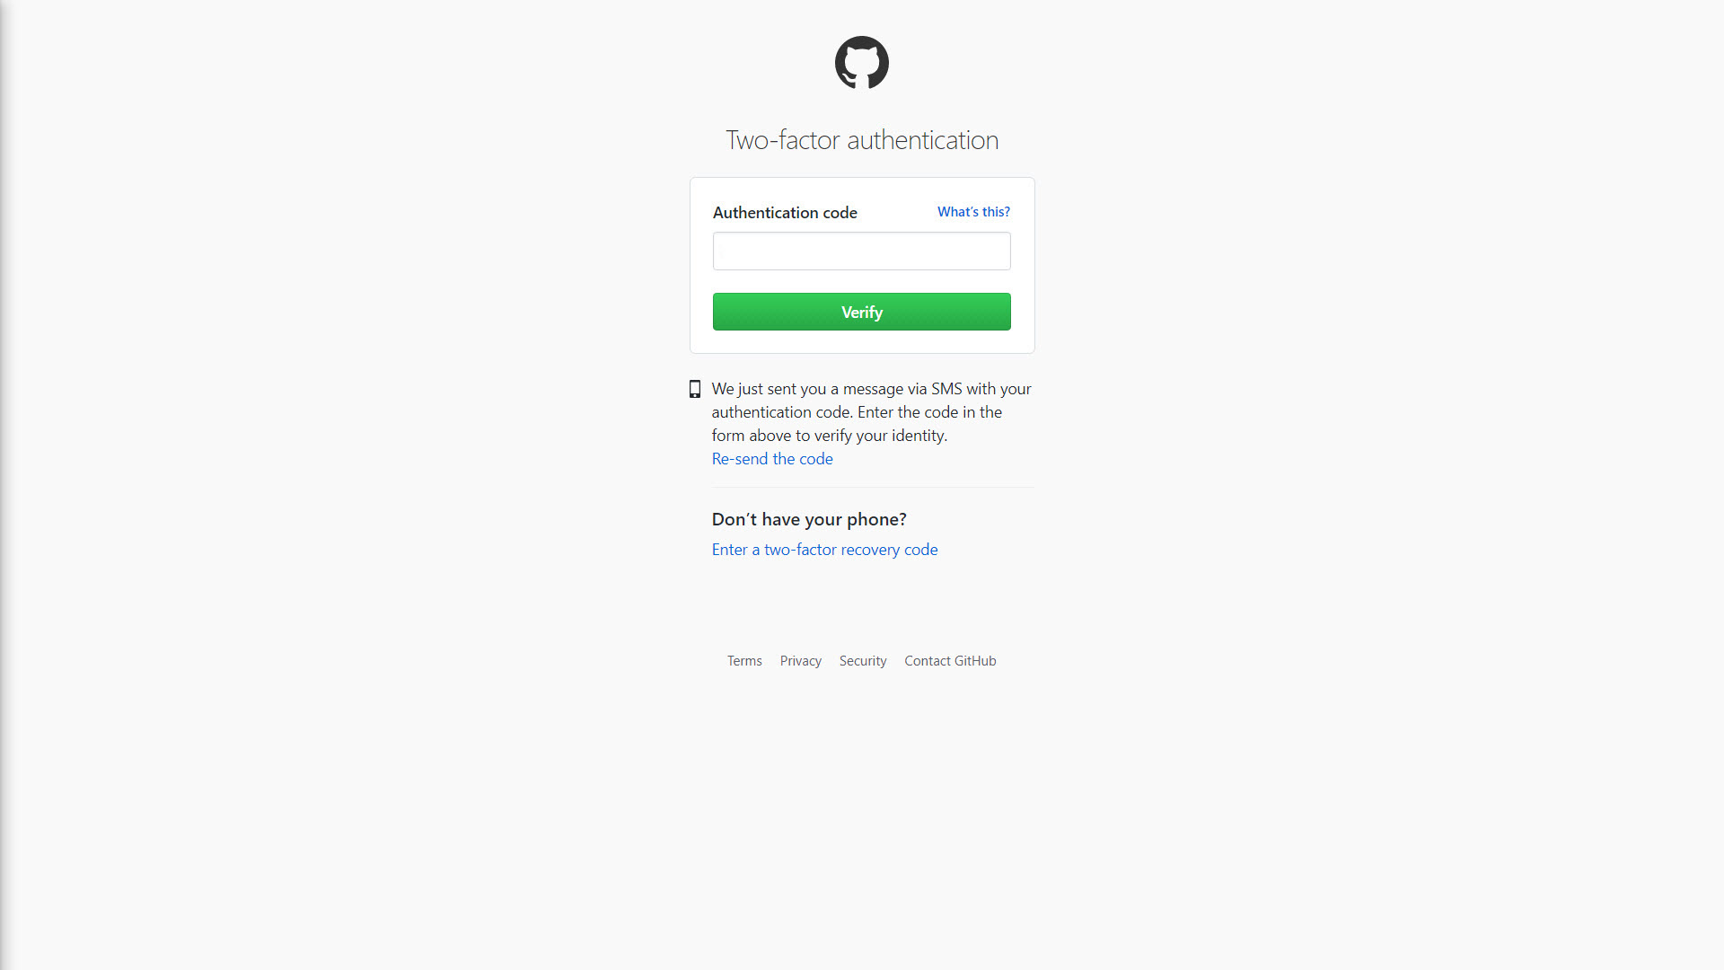
Notes:
This step is only necessary if you have MFA turned on for the account.
Enter Authentication code
Click Verify

Slide 8
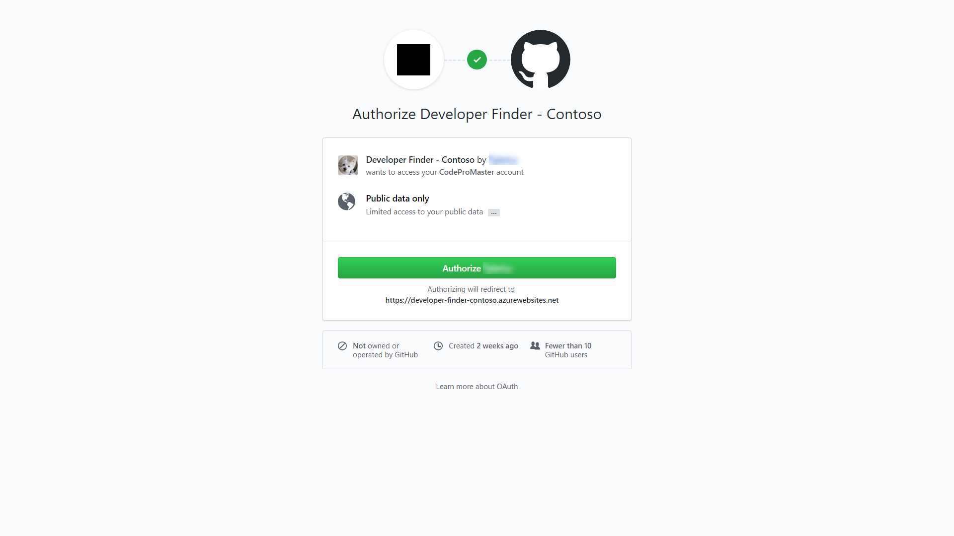
Notes:
1. Click Authorize

Slide 9
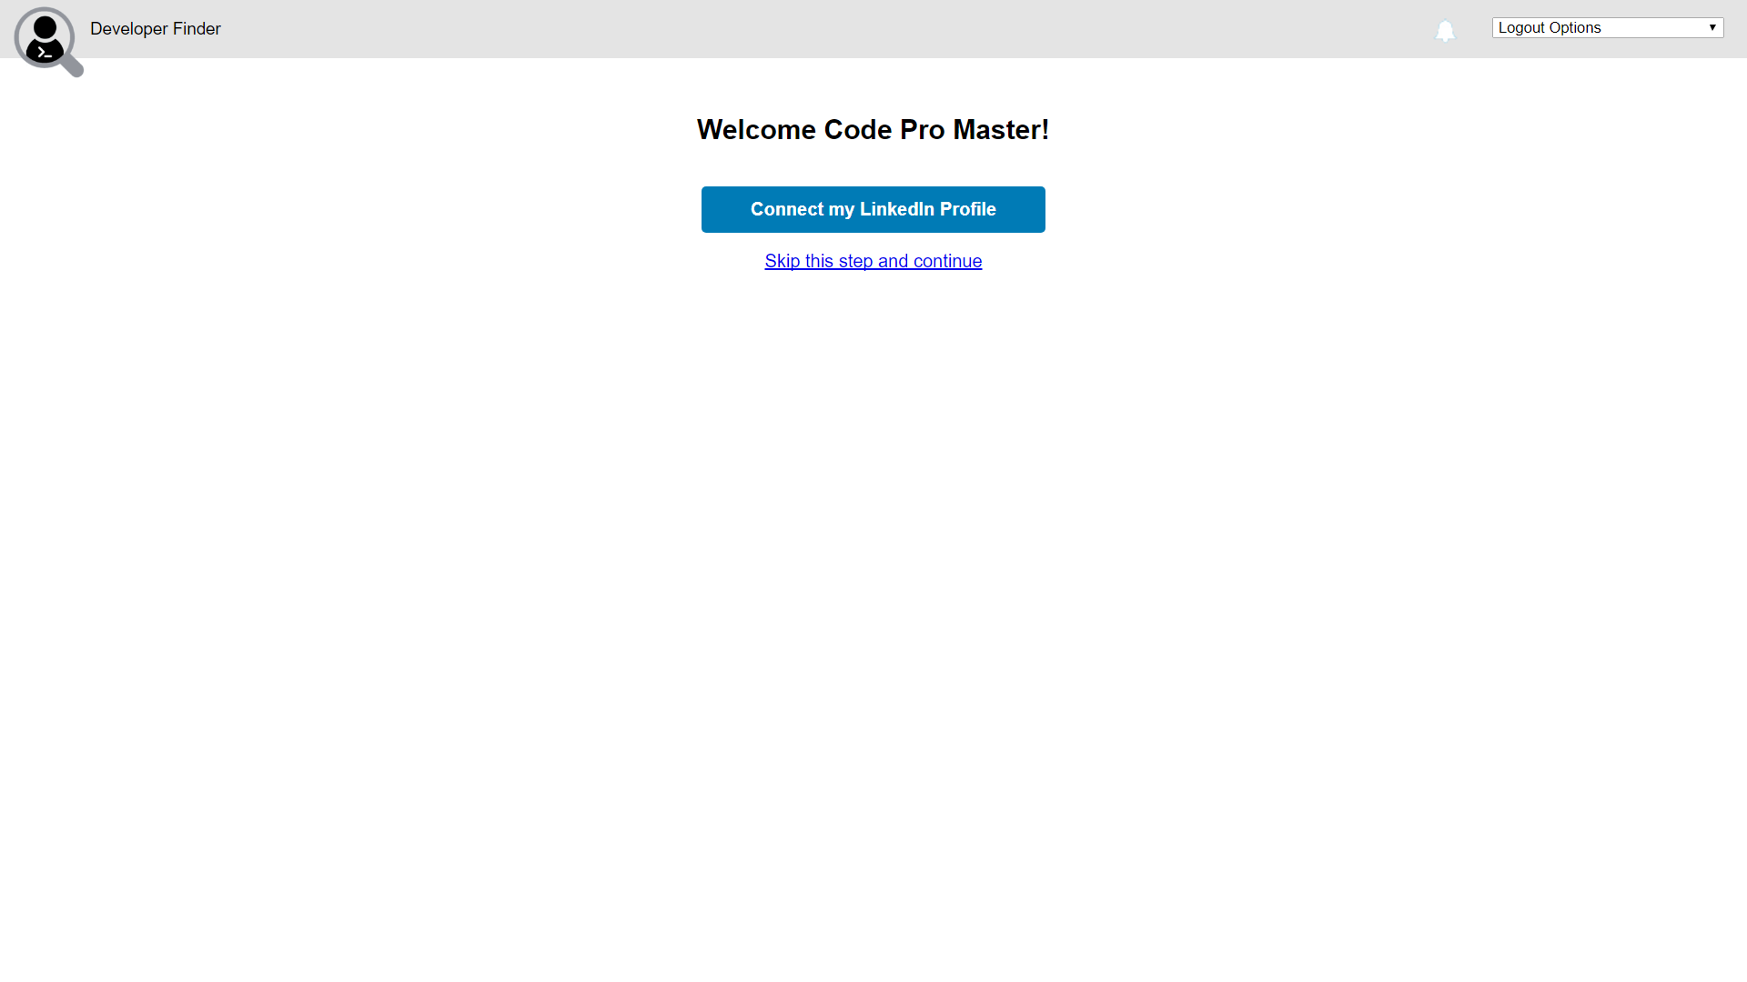
Notes:
1. Click Connect my LinkedIn Profile

Slide 10
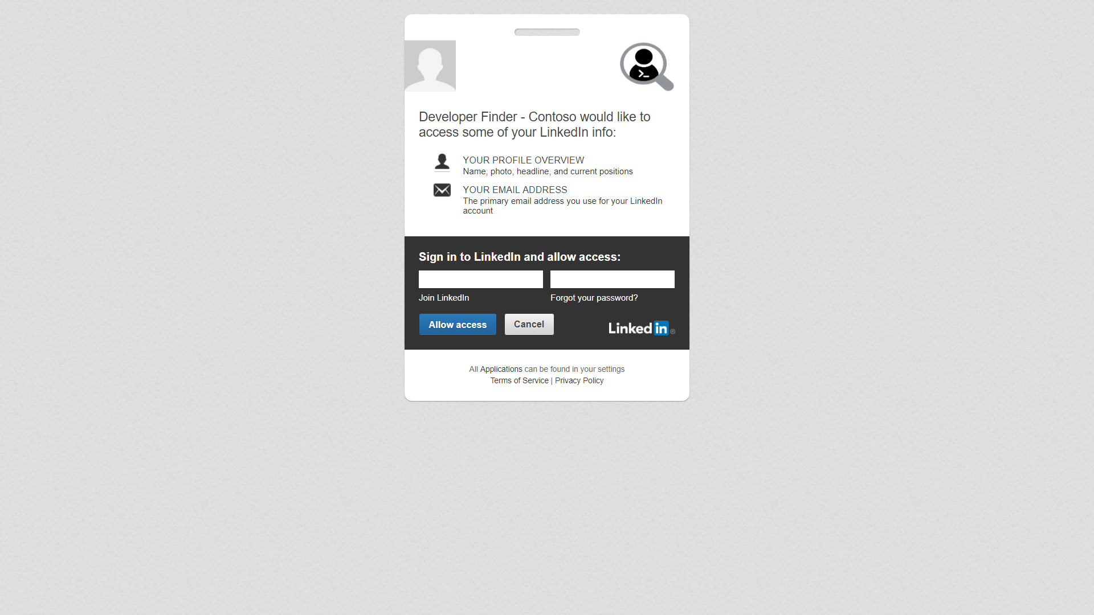
Notes:
Enter email address
Enter password
Click Allow access

Slide 11
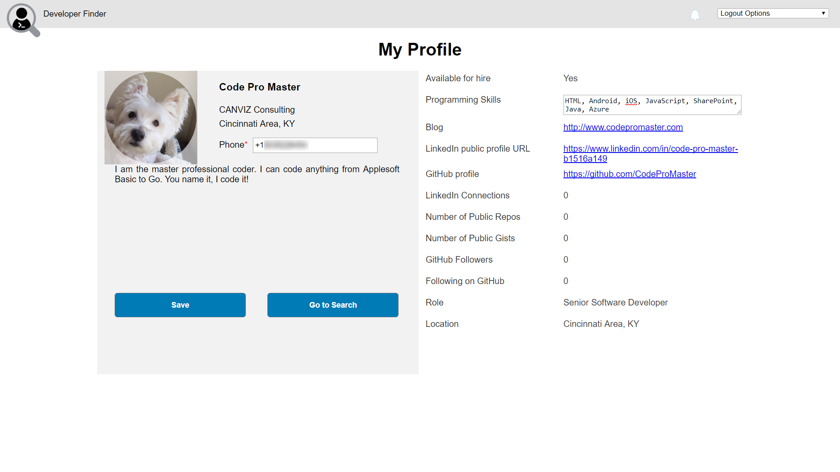
Notes:
Enter phone number
IMPORTANT: You must add the prefix for the country code or the SMS will not be sent.
Example: +15551112222
Enter Programming Skills
It is strongly recommended you enter programming skills that match the skills you created when you sent up the User 2 account.
Doing so will make User 2 show up in the Suggested Friends search result section.
Click Save
Click Go to Search

Slide 12
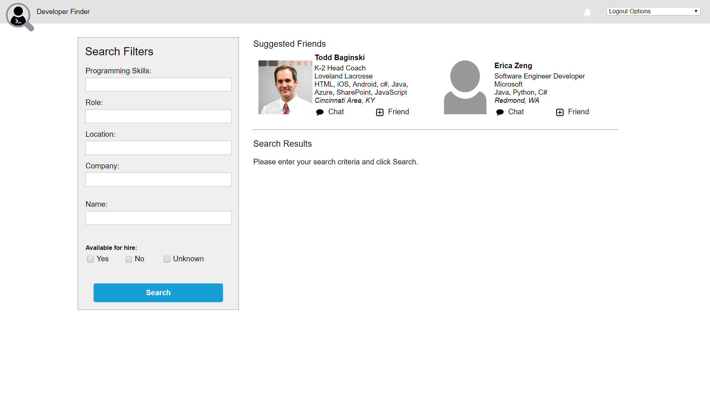
Notes:
Wait until the Suggested Friends search results appear.
Click Search

Slide 13
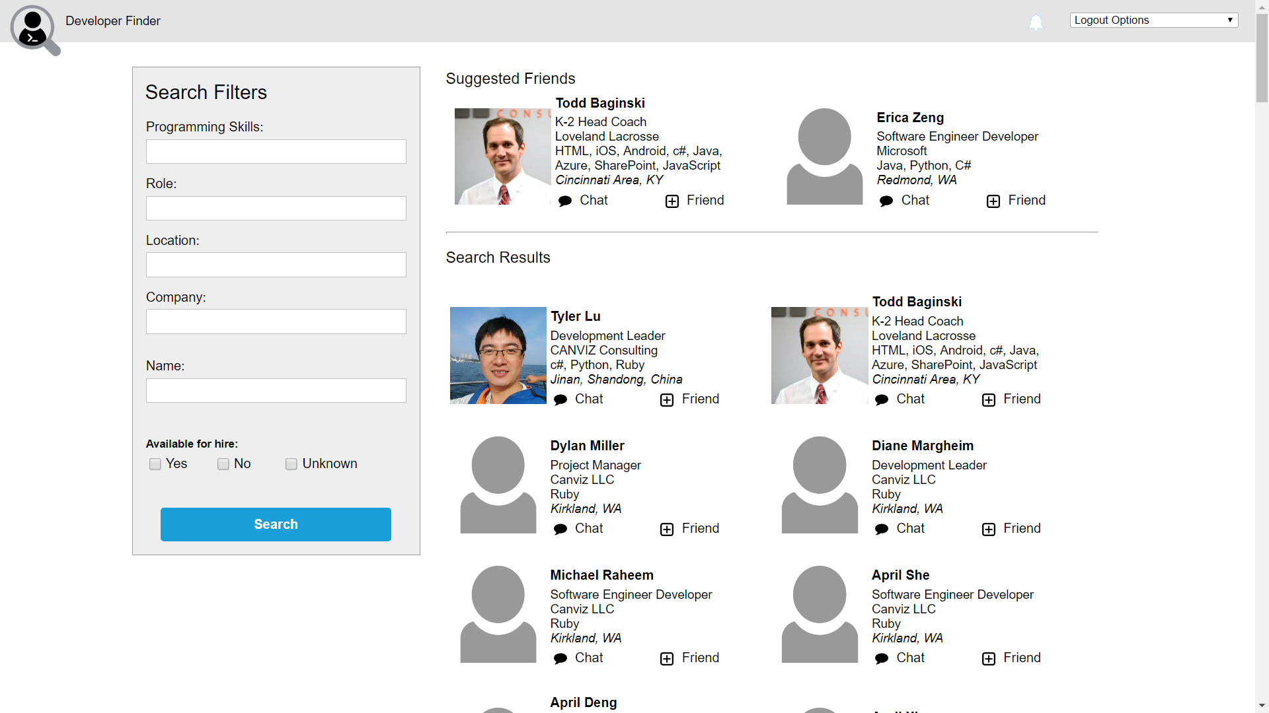
Notes:
1. Click the full name for User 2 you previously set up.

Slide 14
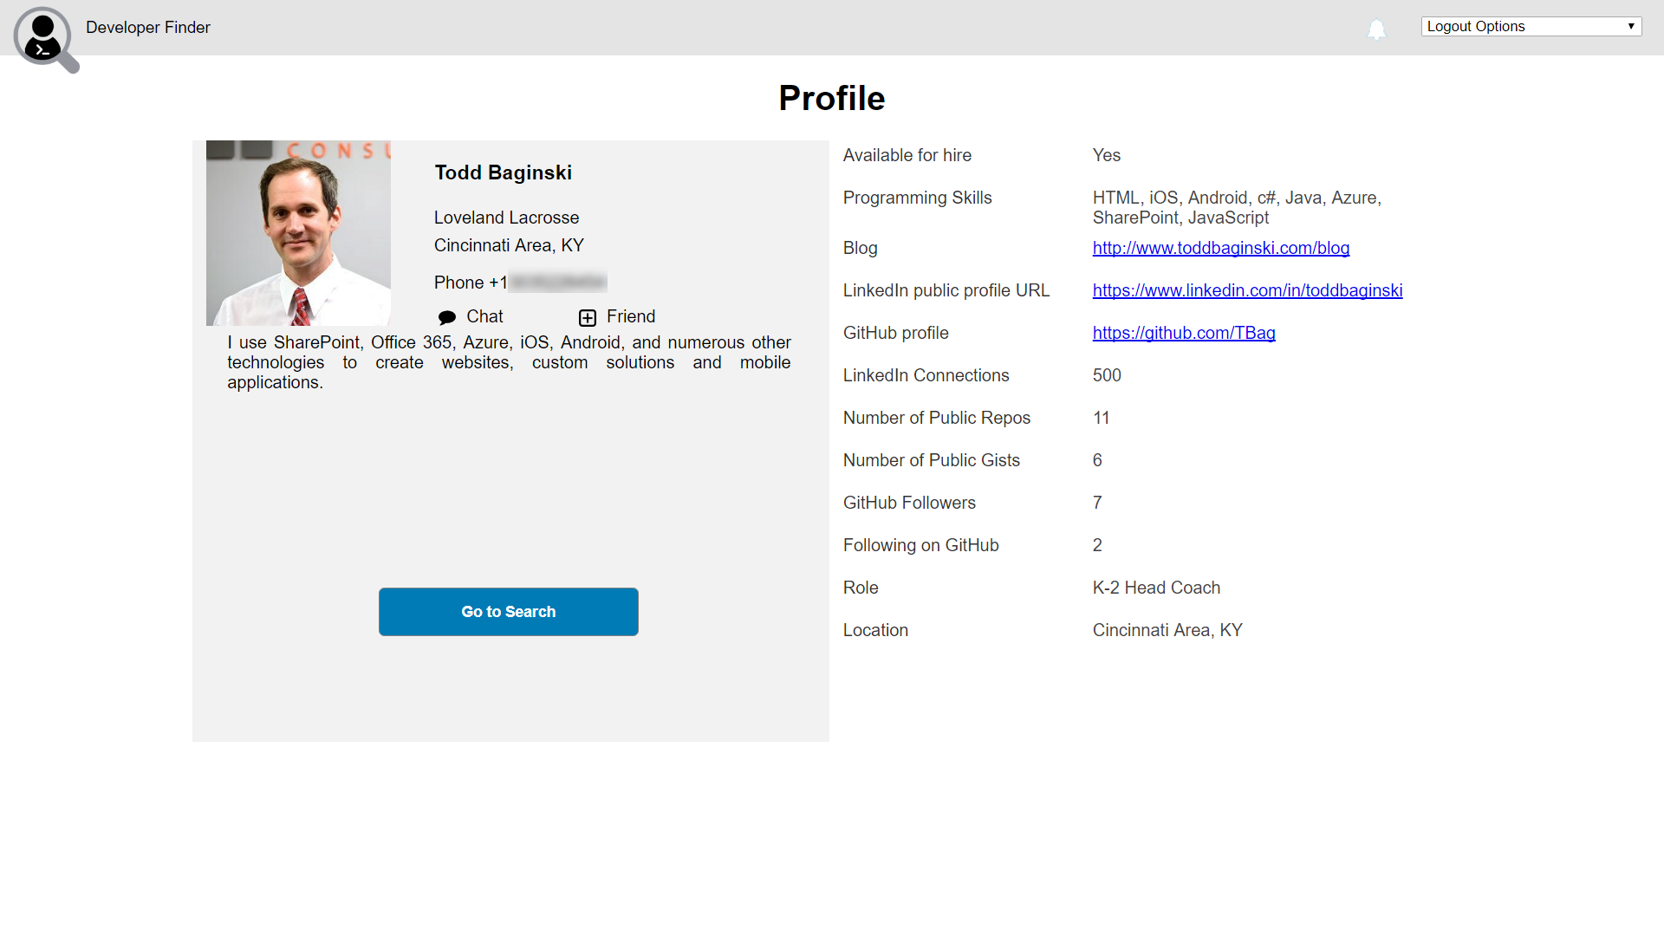
Notes:
1. Click Chat

Slide 15
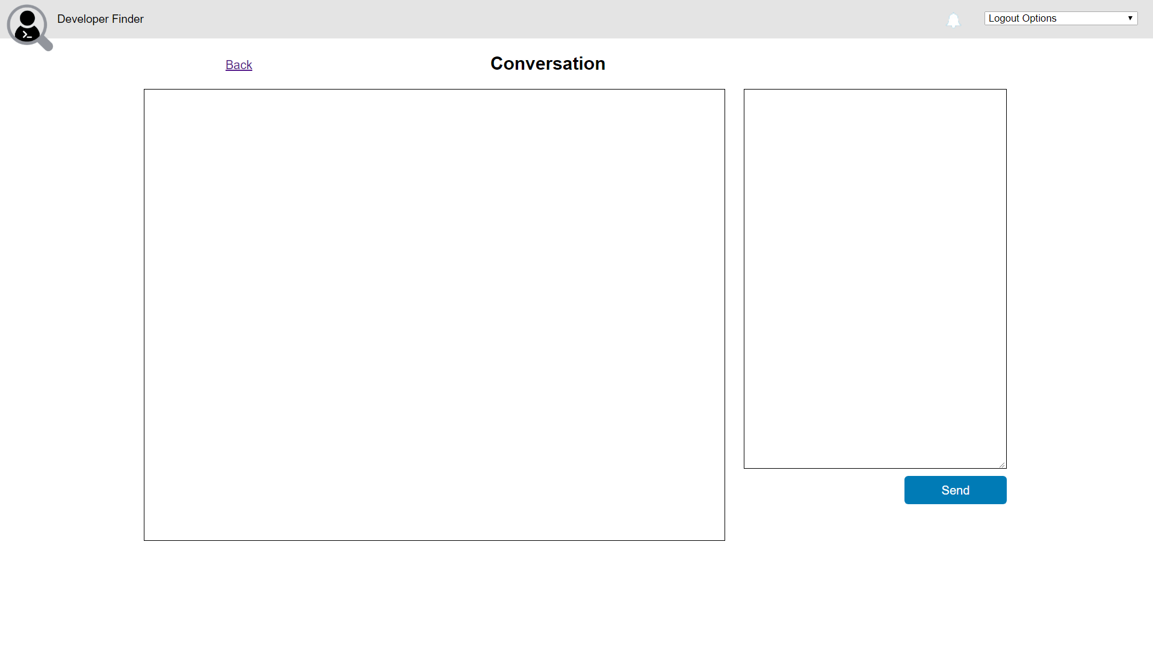

Slide 16
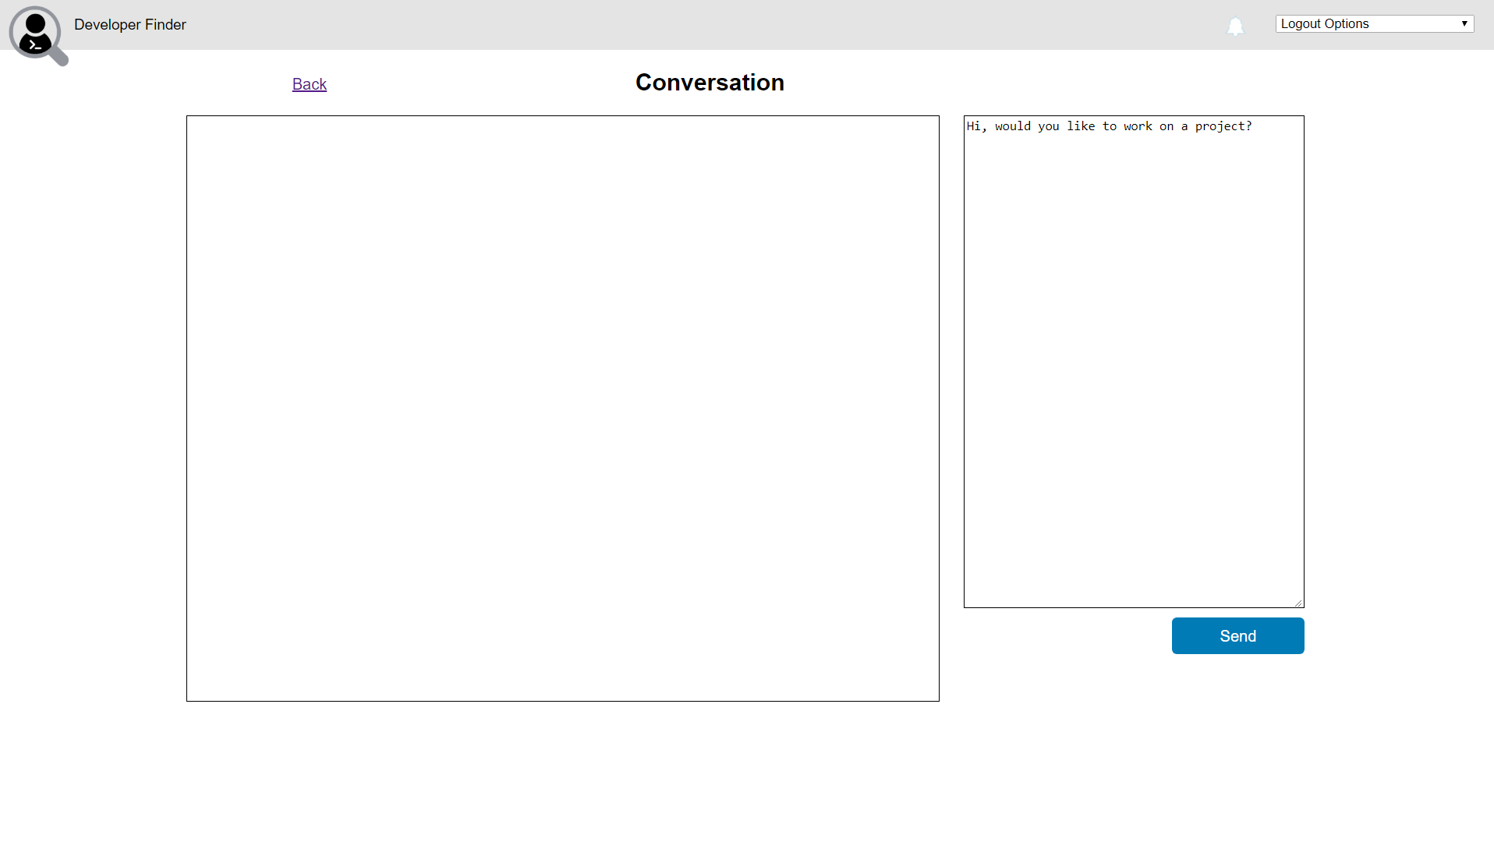
Notes:
Enter the following text in the chat textbox:
Hi, would you like to work on a project?
2. Click Send

Slide 17
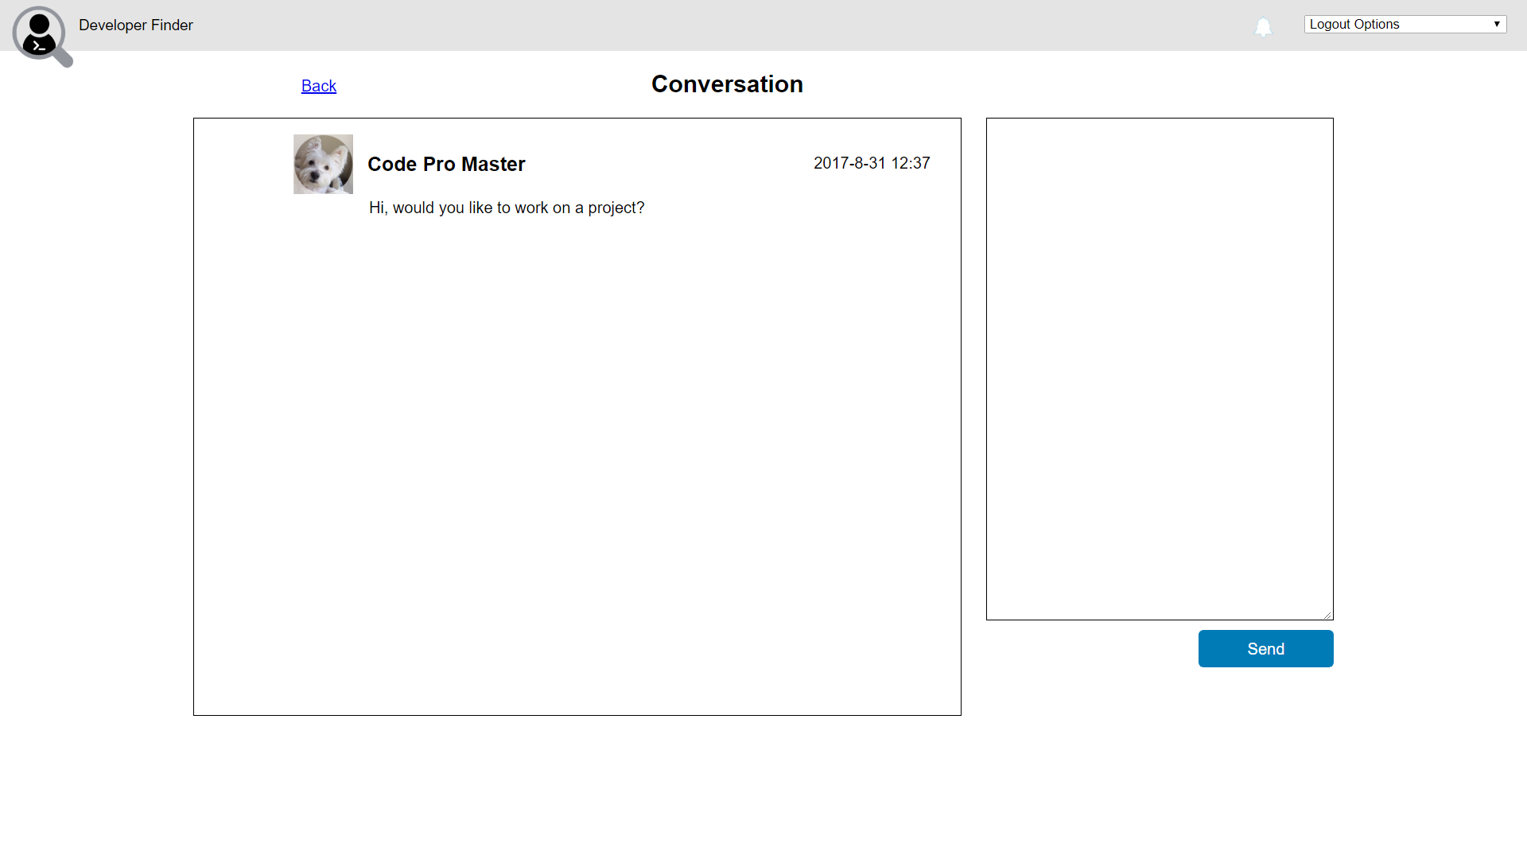
Notes:
1. Watch the chat message appear in the conversation window.

Slide 18
End User Scenario – Part 2
User 2 receives SMS message
User 2 signs in with GitHub or LinkedIn account
User 2 views chat message from user 1
User 2 views user 1's profile
User 2 responds to user 1‘s chat message

Slide 19
User 2
User 2 executes this part of the demo.
User 2 is a developer who has previously registered in the Developer Finder app. This is the User who will be contacted by user 1.
IMPORTANT NOTES:
Before executing the demo you must sign in with User 2 and fill out their phone number and skills.
If you wish to use the SMS text messages, you must also follow the steps in the README file that describe how to register and verify the phone number for the user with the Twilio trial.

Slide 20
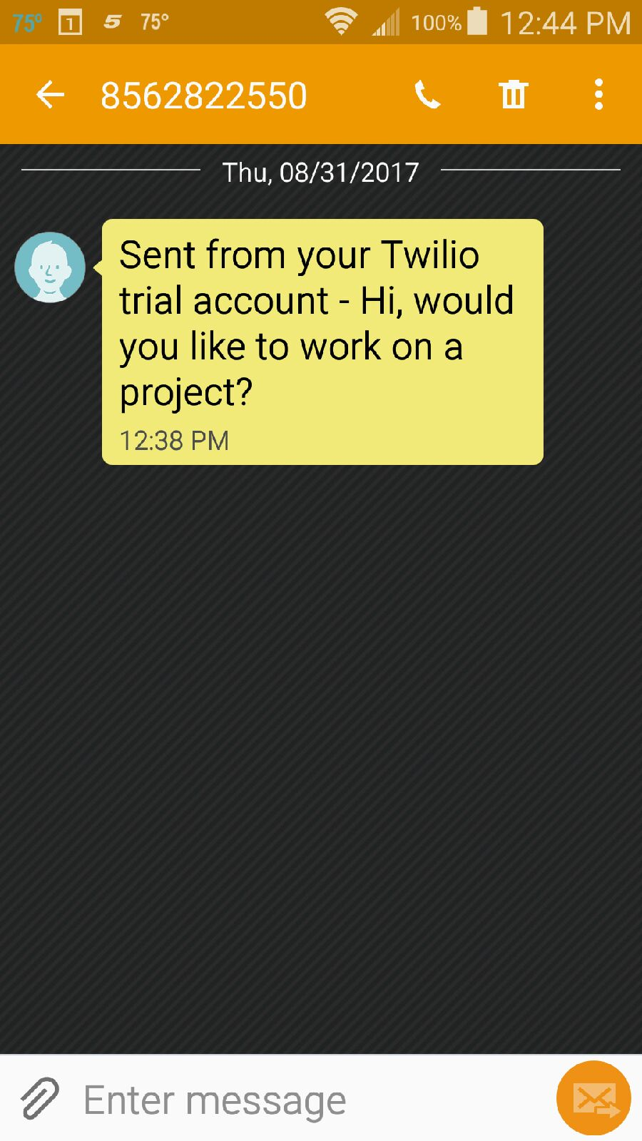
User 2 Views SMS On Phone

Slide 21
Notes:
In a web browser, open the Developer Finder Application
In the GitHub section, click Sign In using GitHub

Slide 22

Notes:
Enter Username or email address
Enter Password
Click Sign in

Slide 23

Notes:
This step is only necessary if you have MFA turned on for the account.
Enter Authentication code
Click Verify

Slide 24
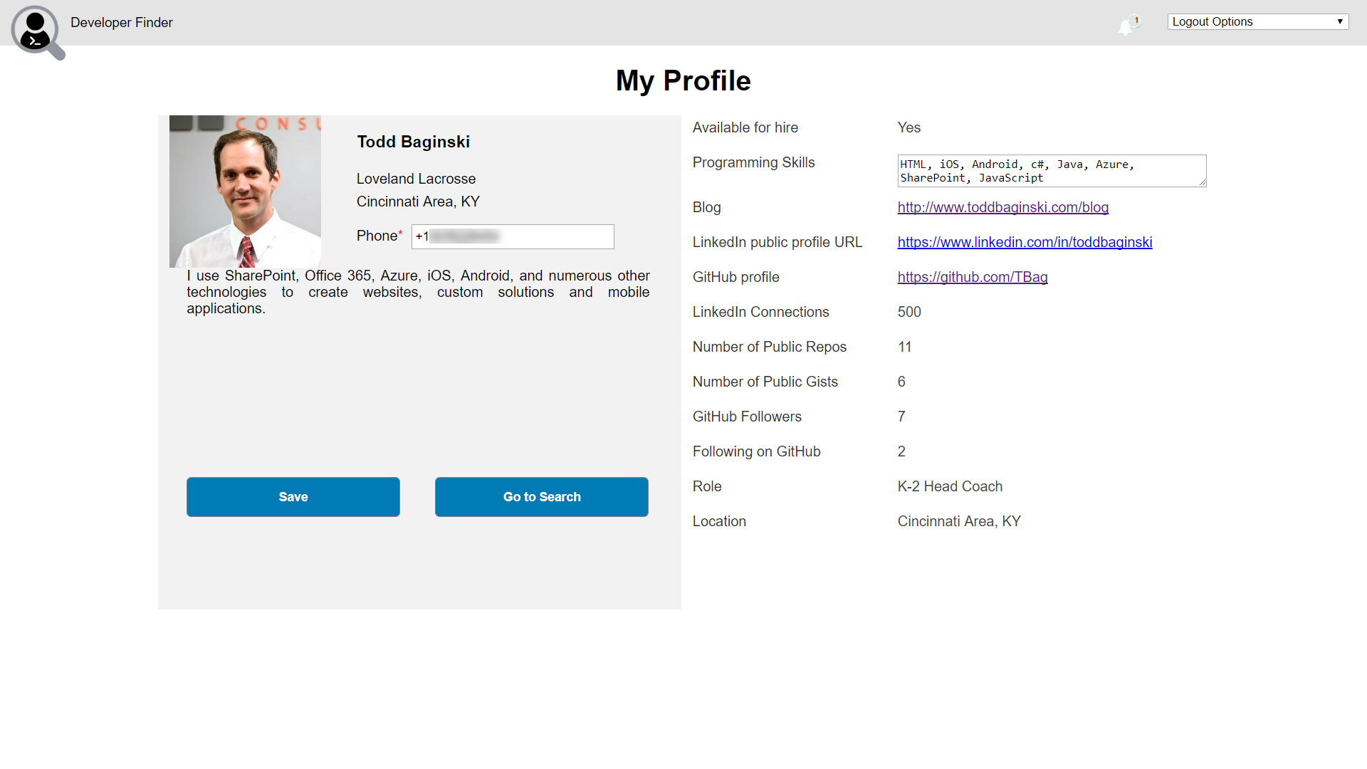
Notes:
1. Click the notification icon

Slide 25
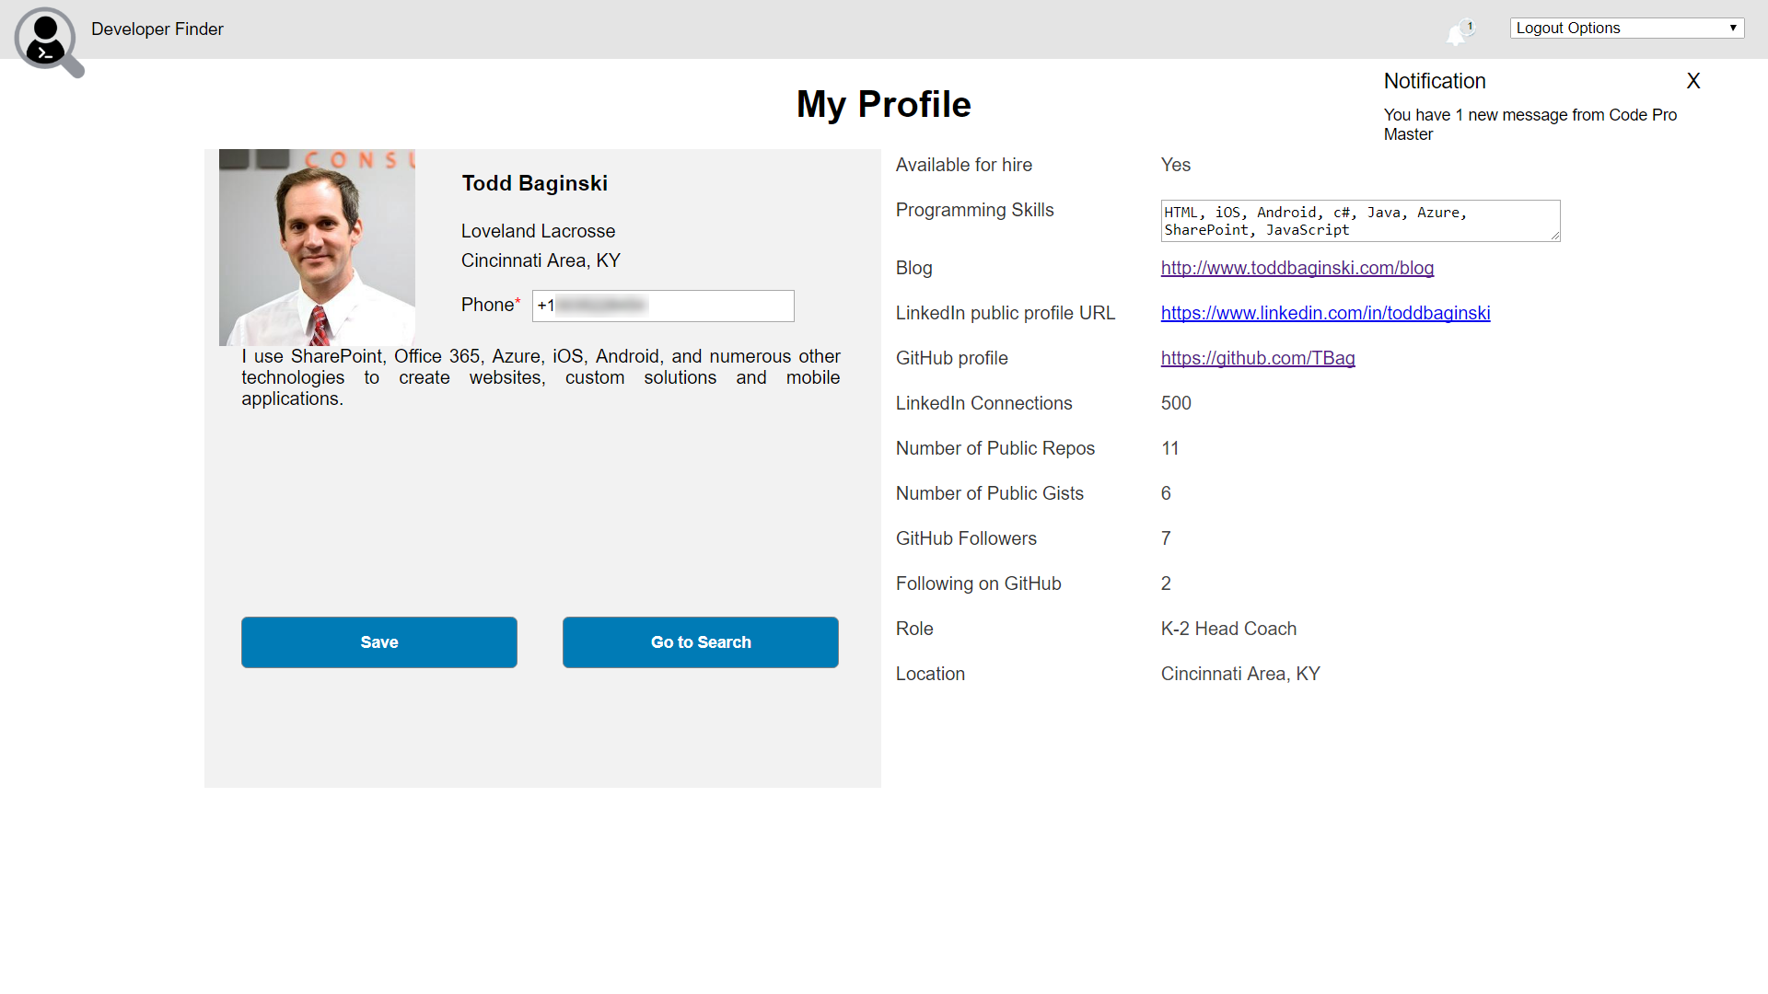
Notes:
1. Click the notification

Slide 26
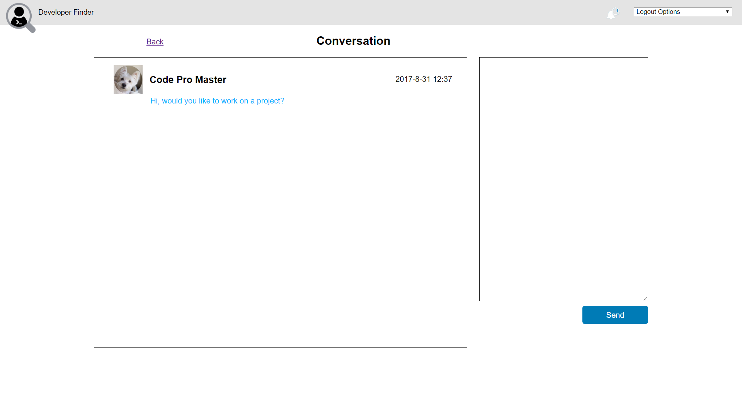
Notes:
1. Click User 1’s name

Slide 27
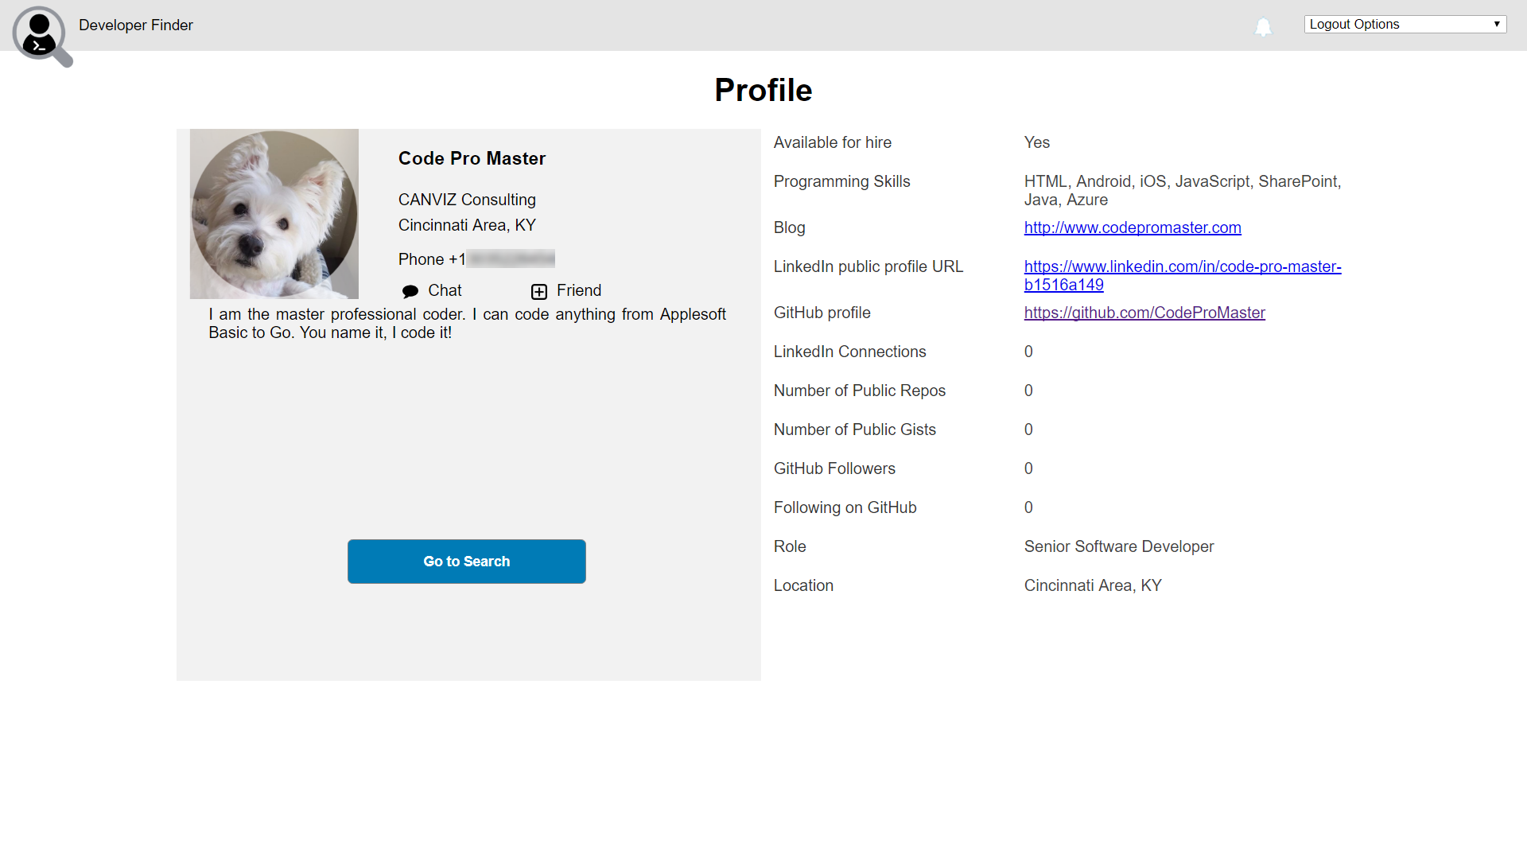
Notes:
1. Click Chat

Slide 28
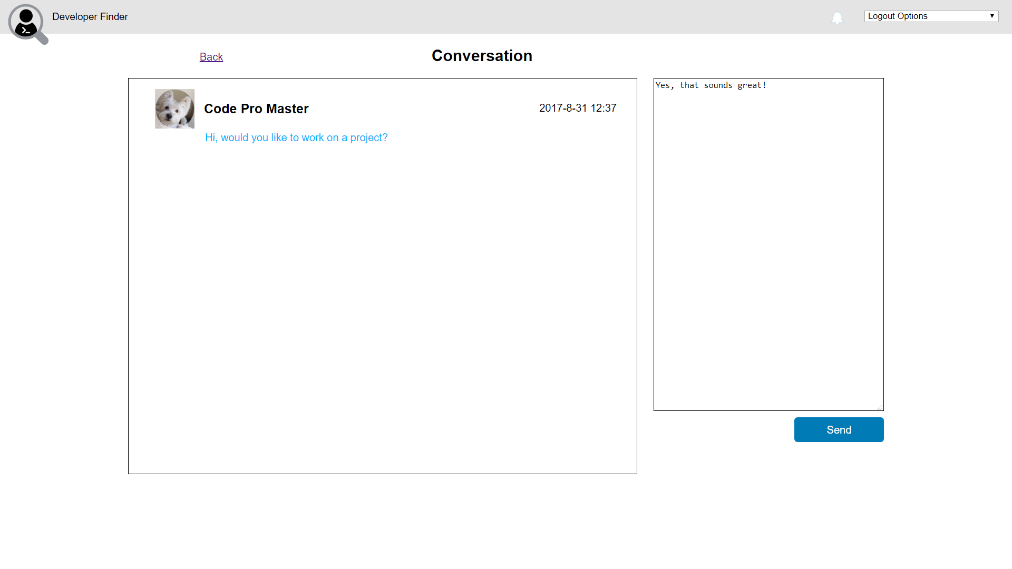
Notes:
Enter the following text in the chat textbox:
Yes, that sounds great!
2. Click Send

Slide 29
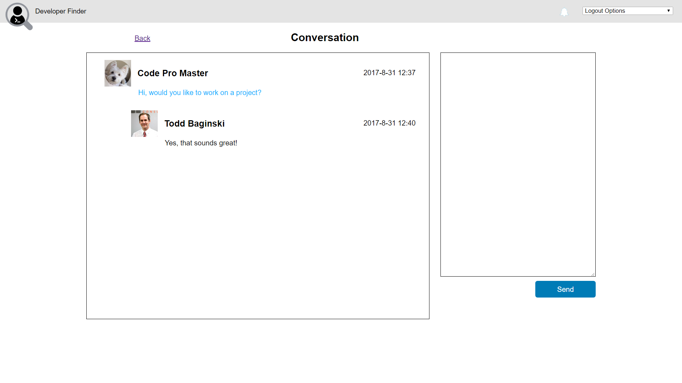
Notes:
1. Watch the chat message appear in the conversation window

Slide 30
End User Scenario – Part 3
User 1 signs in with GitHub or LinkedIn account
User 1 views chat message from user 2
User 1 responds to user 2‘s chat message
User 1 makes user 2 a friend

Slide 31
User 1
User 1 executes this part of the demo.

Slide 32
Notes:
In a web browser, open the Developer Finder Application
In the GitHub section, click Sign In

Slide 33
Notes:
Enter Username or email address
Enter Password
Click Sign in

Slide 34
Notes:
This step is only necessary if you have MFA turned on for the account.
Enter Authentication code
Click Verify

Slide 35
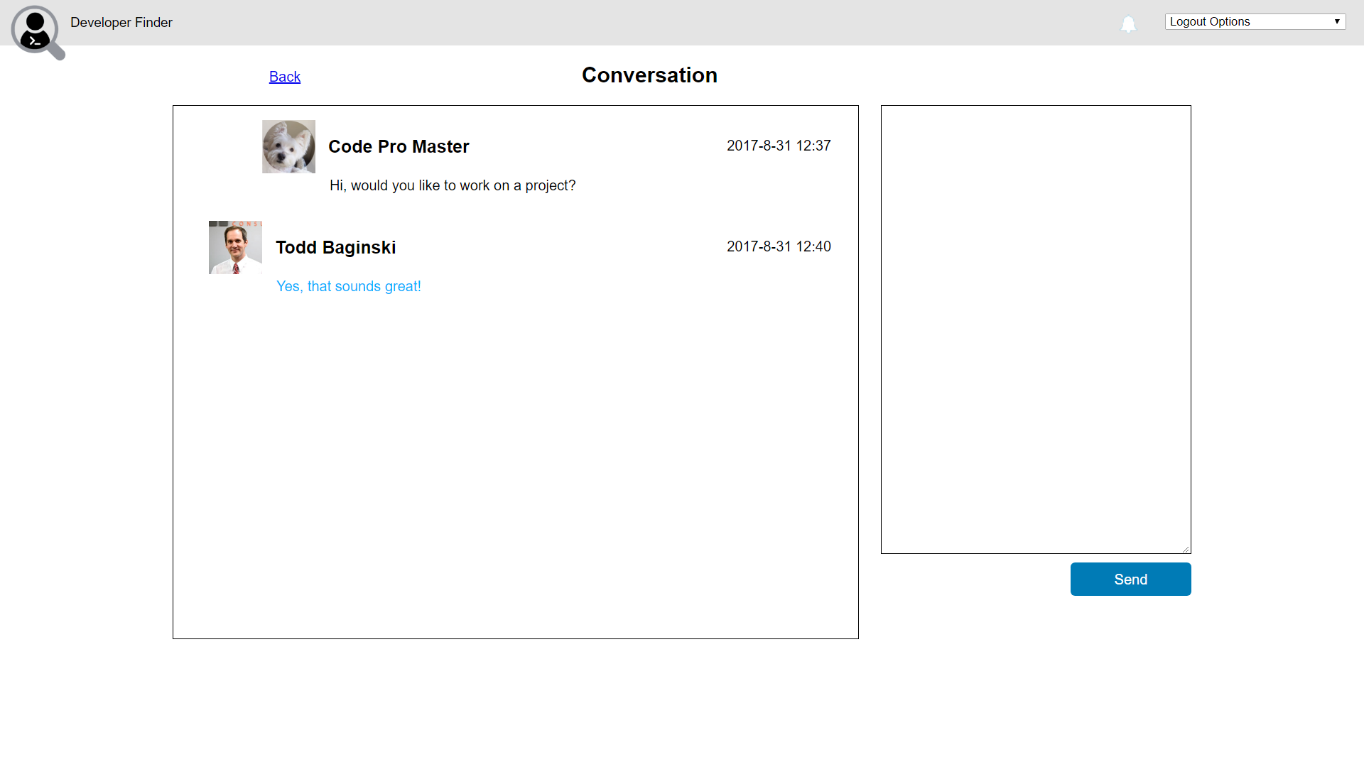
Notes:
1. View the chat message

Slide 36
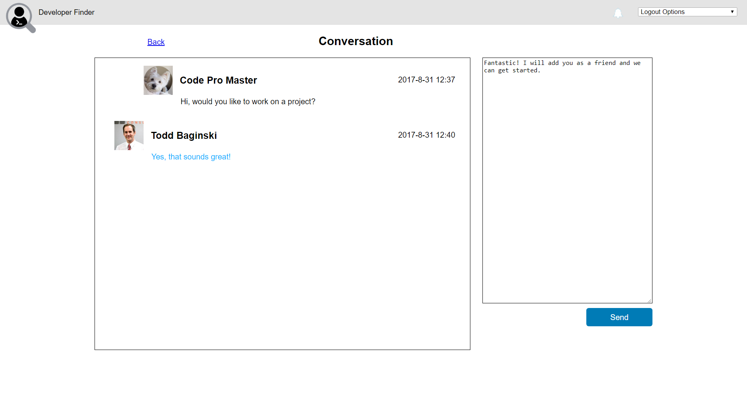
Notes:
Enter the following text in the chat textbox:
Fantastic! I will add you as a friend and we can get started.
2. Click Send

Slide 37
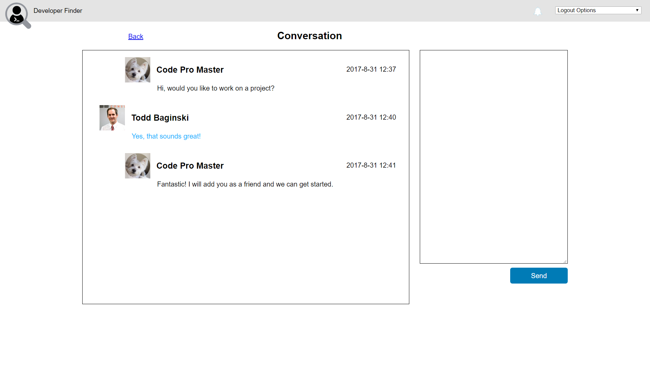
Notes:
Watch the chat message appear in the conversation window
Click User 2’s name

Slide 38

Notes:
1. Click Friend

Slide 39

Notes:
1. Watch the Friend icon change to indicate the friend was added

Slide 40
DevOps Scenario (CI / CD) – Part 1
Developer clones web app GitHub project repository
Developer changes code (uncomments) in the web page to display banner ad on the home page and all other pages
Developer pushes changes to web app GitHub repository
VSO Build Definition starts and builds code and deploys it to staging slot
Developer logs into Azure Portal
Developer swaps staging and production slots
Developer sets scaling options and clones to another geolocation

Slide 41
Developer 1
Developer 1 executes this part of the demo.
Developer 1 is a user who has access to the resource group where the Developer Finder application is deployed.

Slide 42
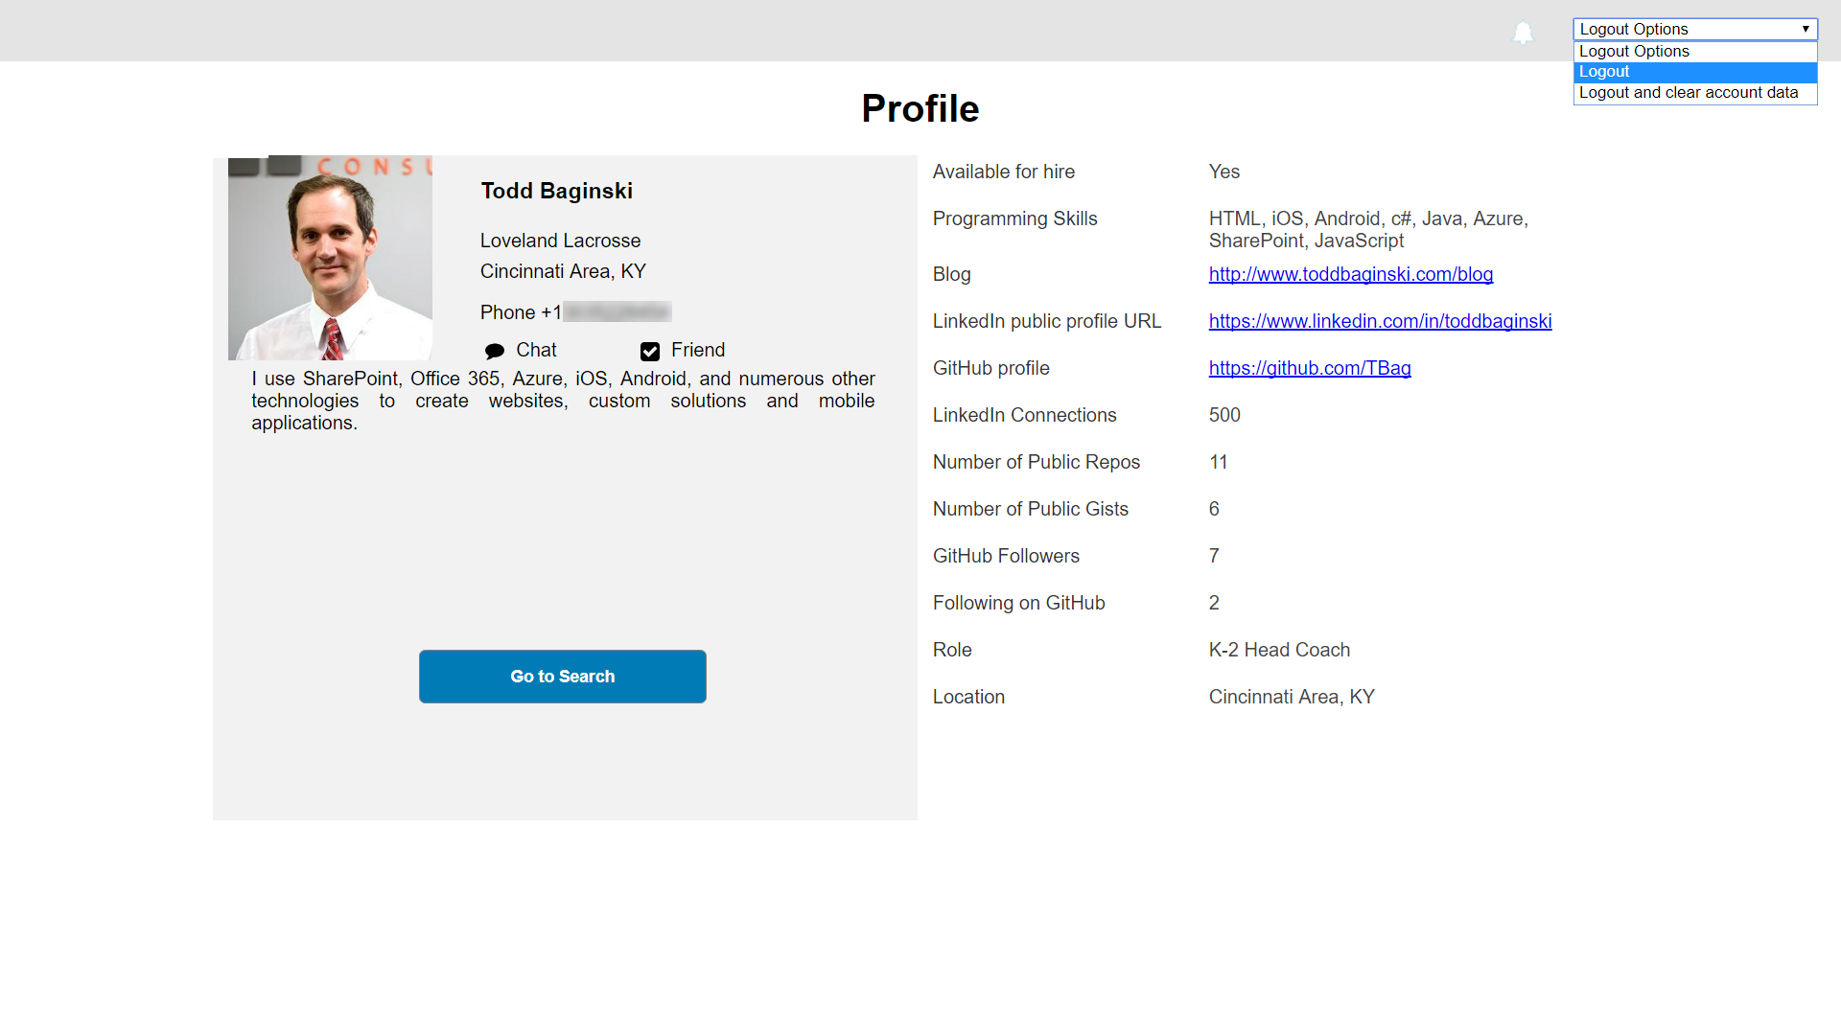
Notes:
Logout the app.
You will be redirected to the login page.

Slide 43
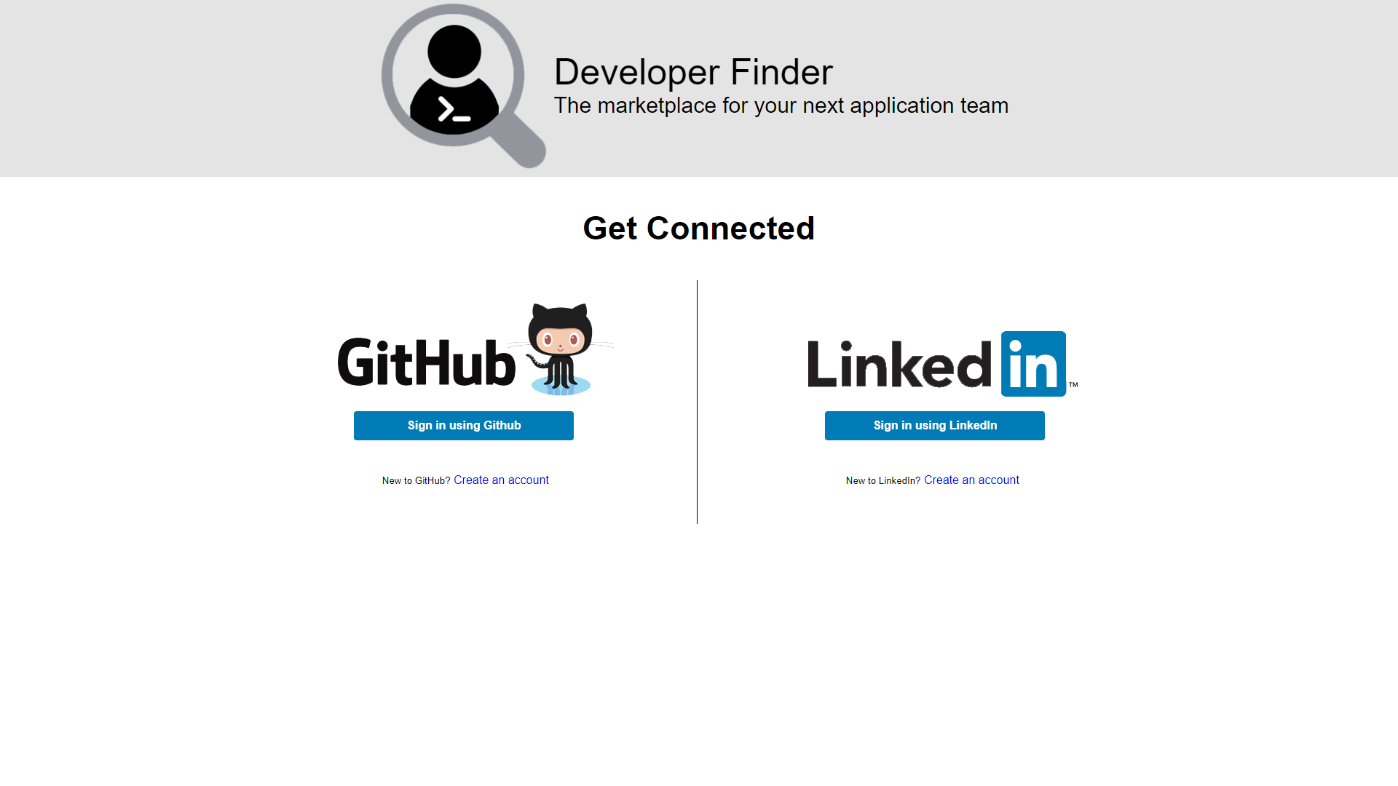
Notes:
Please notice that there is no banner.

Slide 44
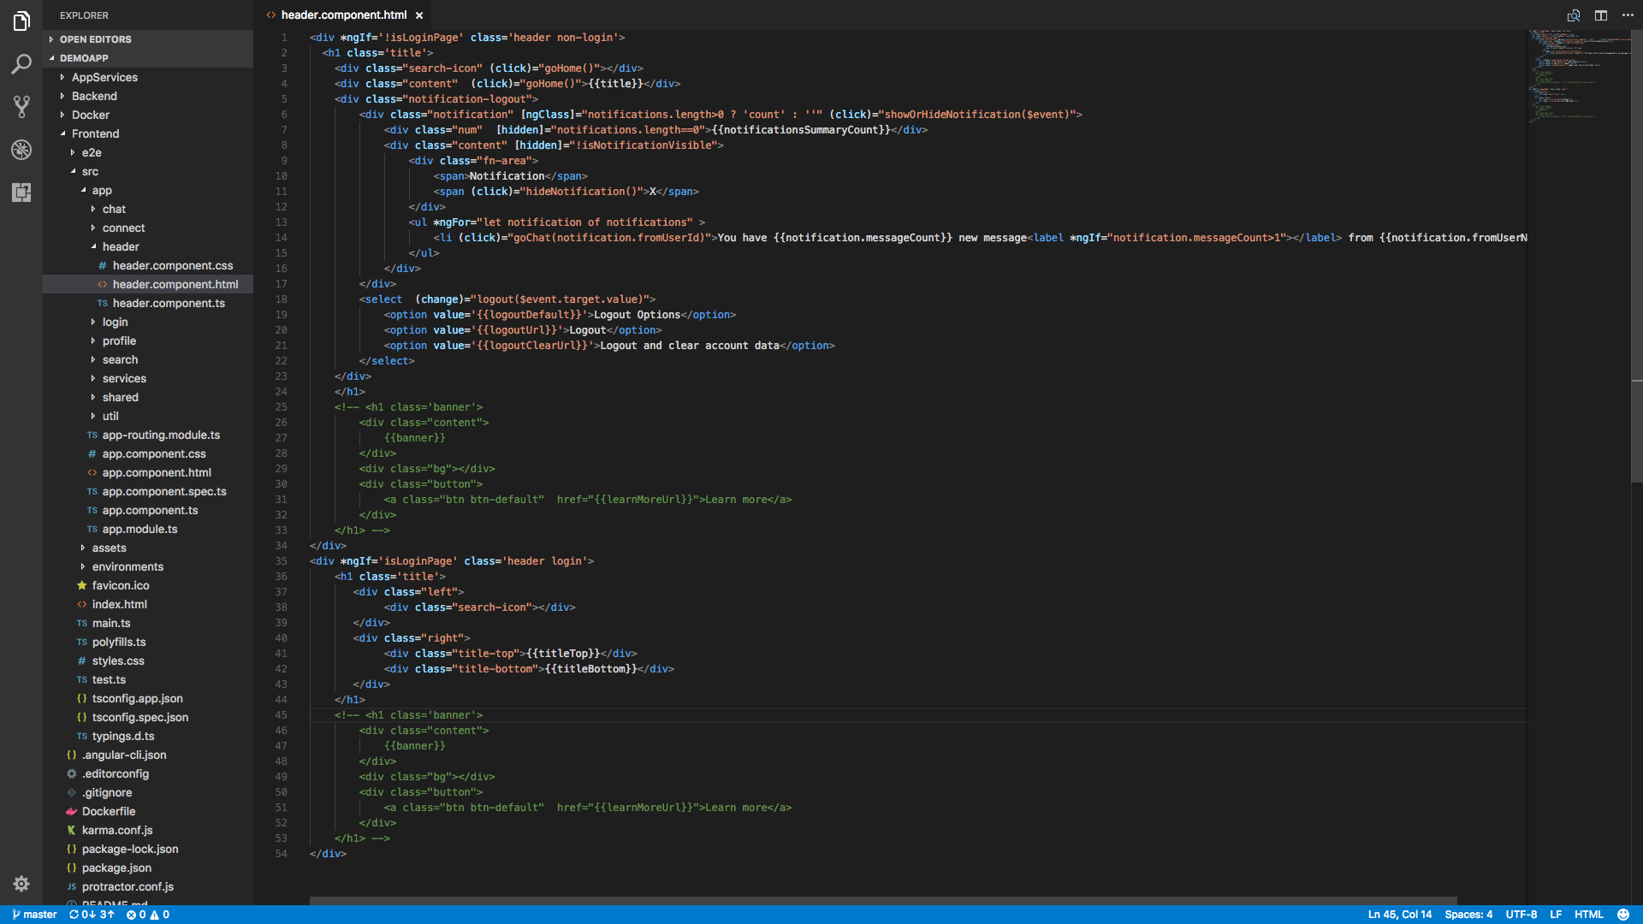
Notes:
Open /Frontend/src/app/header/header.component.html
Uncomment code from L45 to L53.
Save the file.

Slide 45
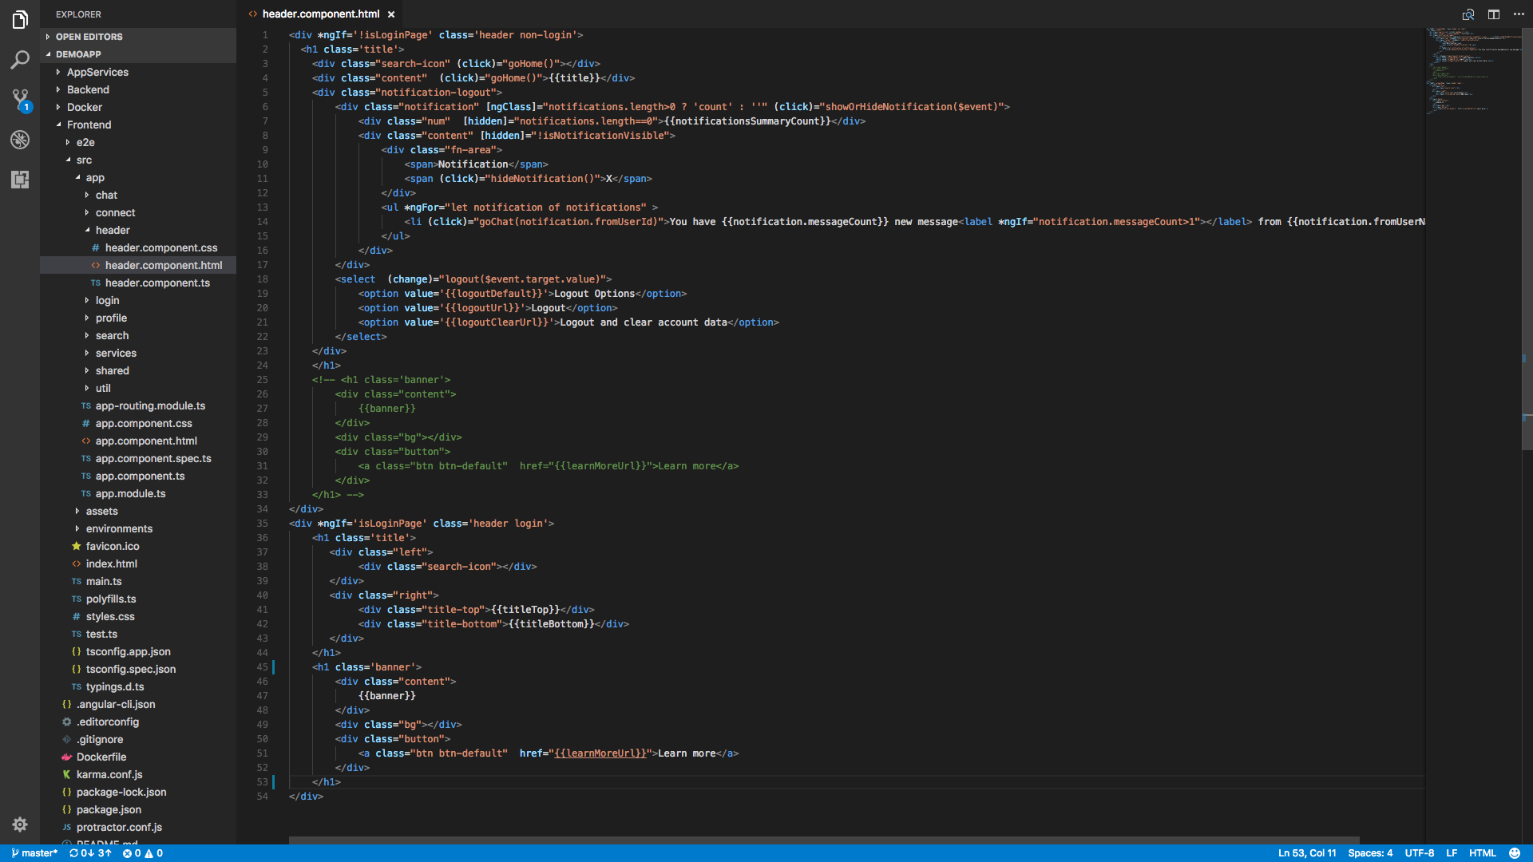
Notes:
1. Click source control

Slide 46
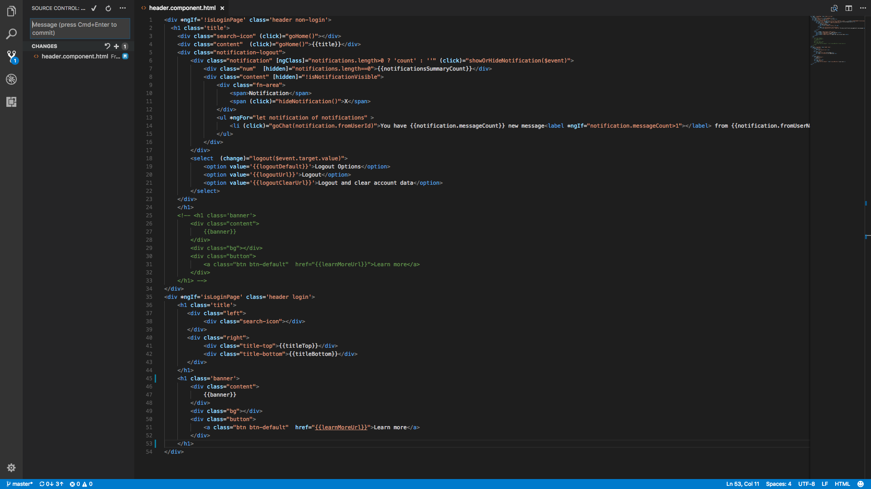
Notes:
Click +

Slide 47
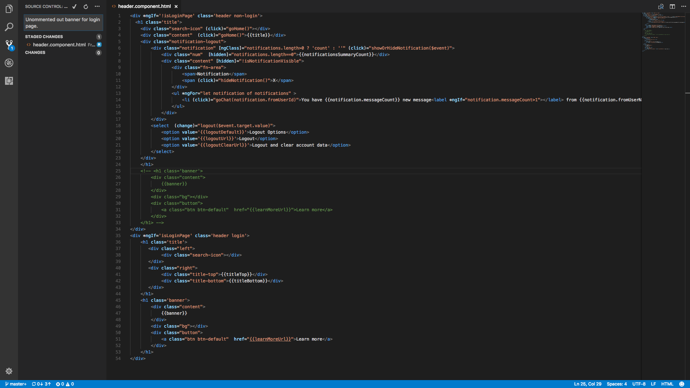
Notes:
Input a comment: Uncmmented out banner for login page.
Click ✓

Slide 48
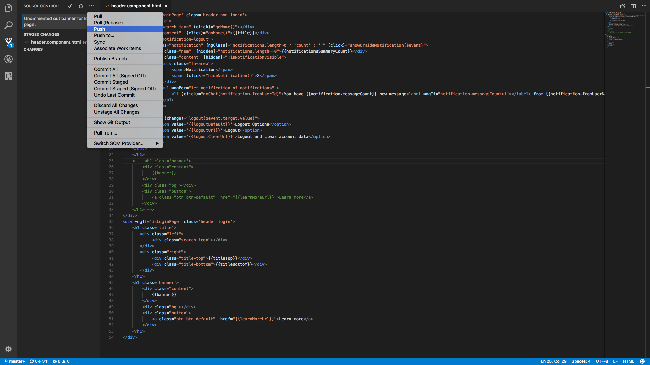
Notes:
Click · · ·
Click push

Slide 49
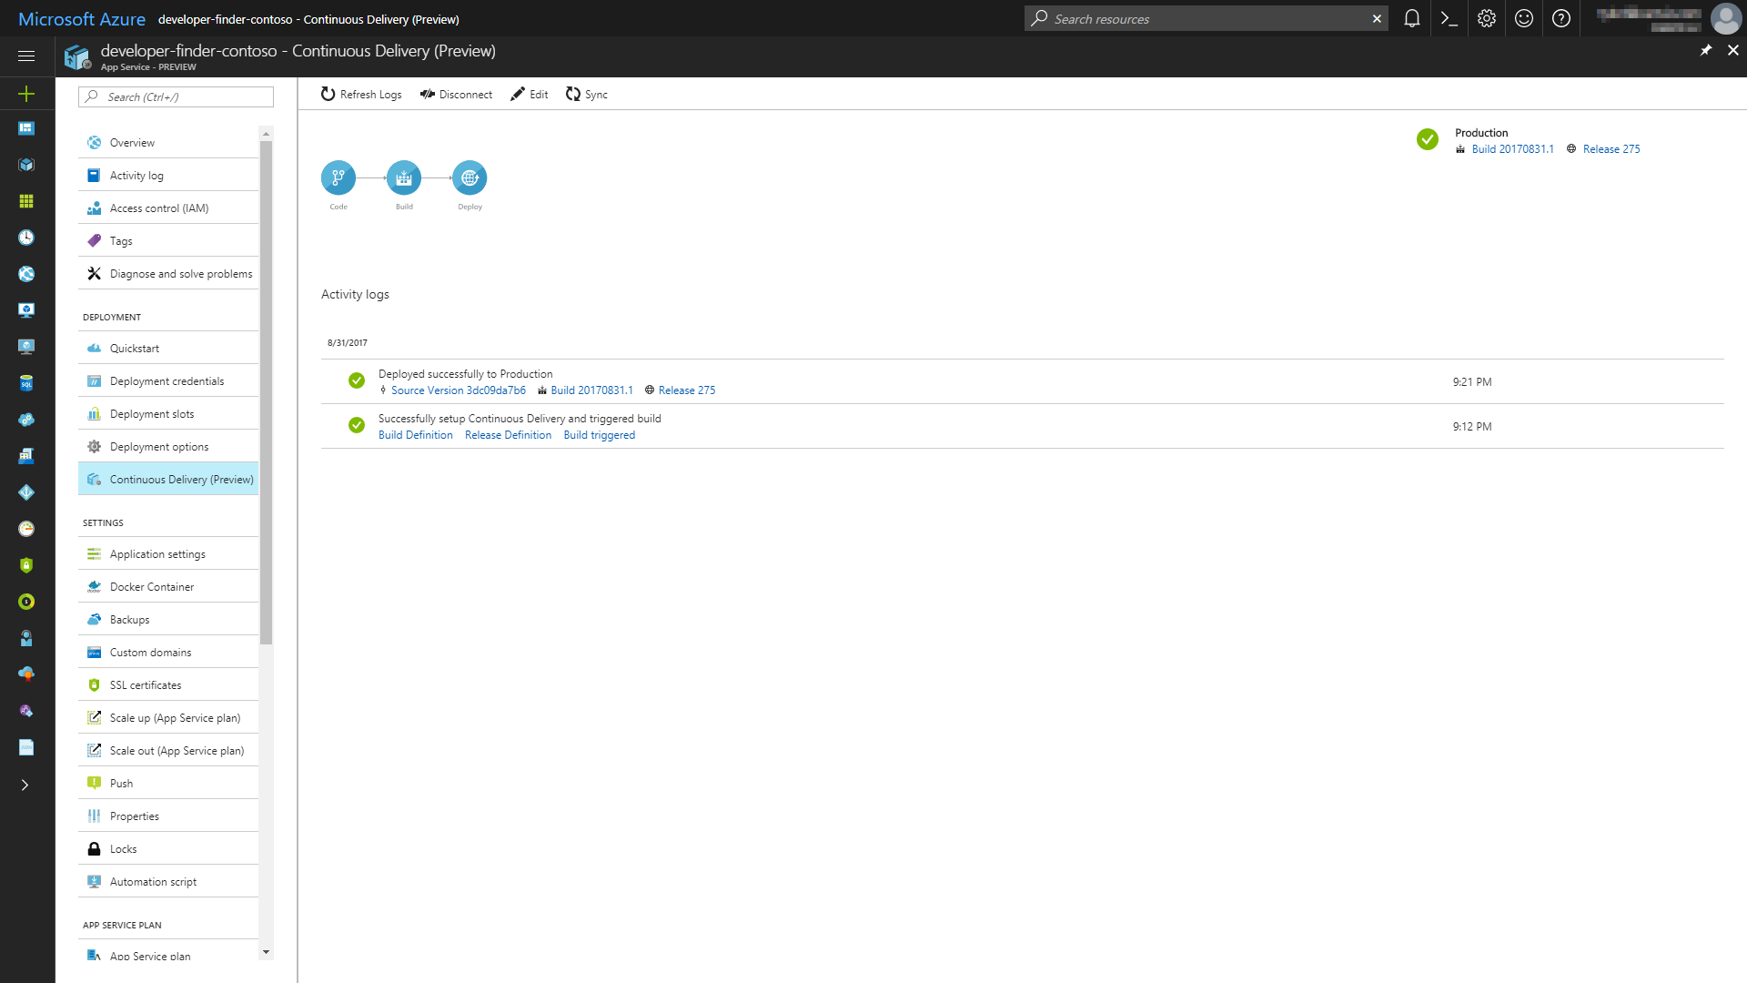
Notes:
1. Click Build Definition

Slide 50
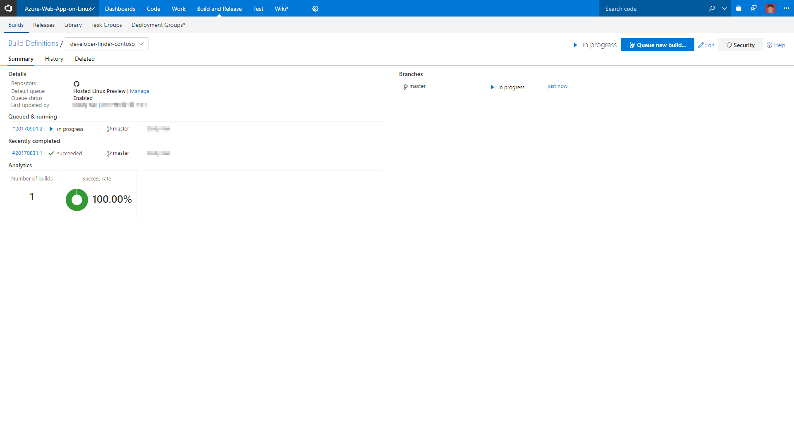
Notes:
1. Click the running build

Slide 51
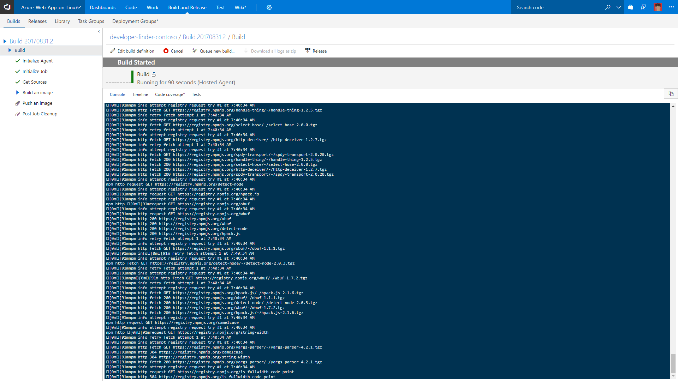

Slide 52
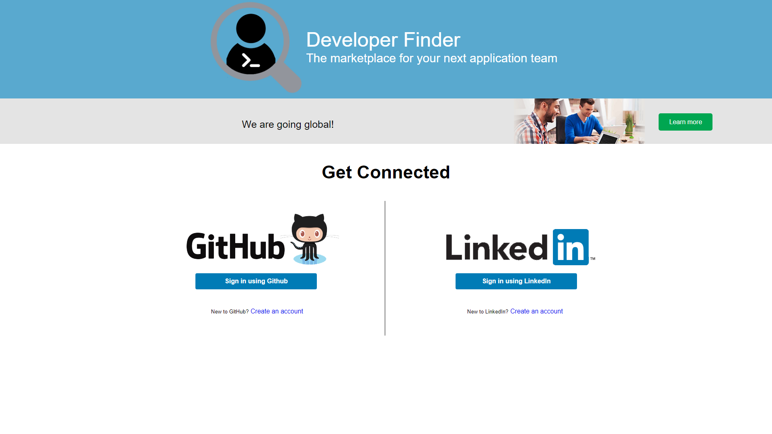
Notes:
1. Wait for about 10 minutes, then refresh the login page, you will see the banner. Note: If you see 502 Bad Gateway, please wait for a few minutes then refresh the page.

Slide 53
DevOps Scenario (CI / CD) – Part 2
User 1 signs in with GitHub or LinkedIn account
User 1 views banner ad on web site

Slide 54
User 1
User 1 executes this part of the demo.

Slide 56
Logic App / Functions Deep Dive
Developer logs into Azure Portal
Developer opens resource group
Developer opens send-sms Logic App
Developer inspects send-sms Logic App in Edit Mode and shows the calls to Twilio
Developer opens Function App
Developer inspects Function App in Edit Mode and shows calls to Application Insights
Developer inspects Application Insights logs in Azure Portal and shows the custom events that are logged by the system

Slide 57
Developer 1
Developer 1 executes this part of the demo.

Slide 58
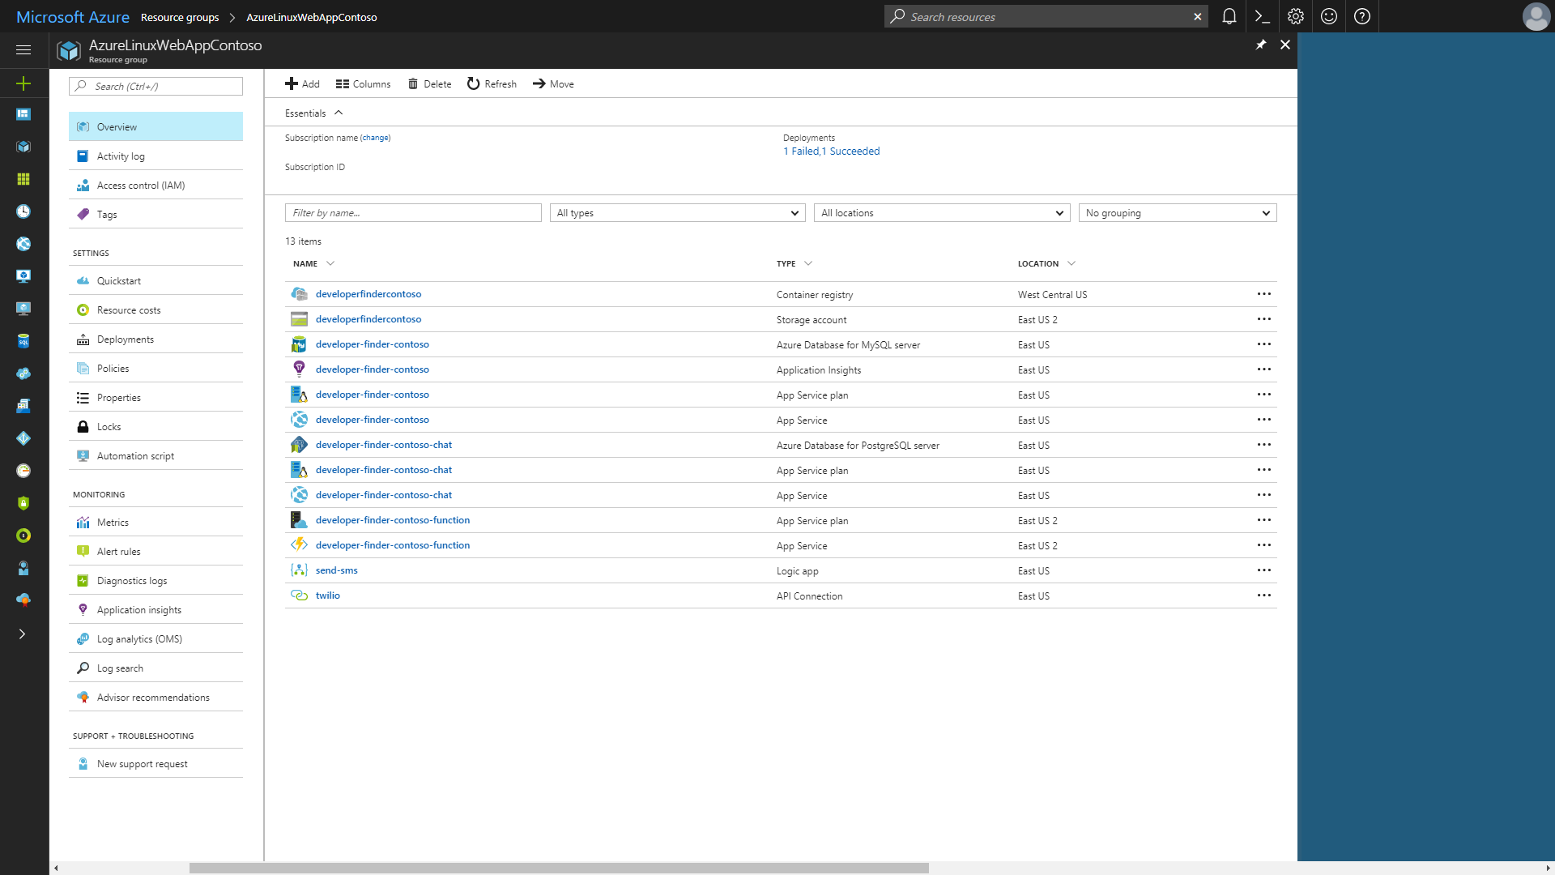
Notes:
In a web browser open the Azure Portal
Log in
Open the Resource Group where the Developer Finder Application is deployed
Click the Logic App

Slide 59
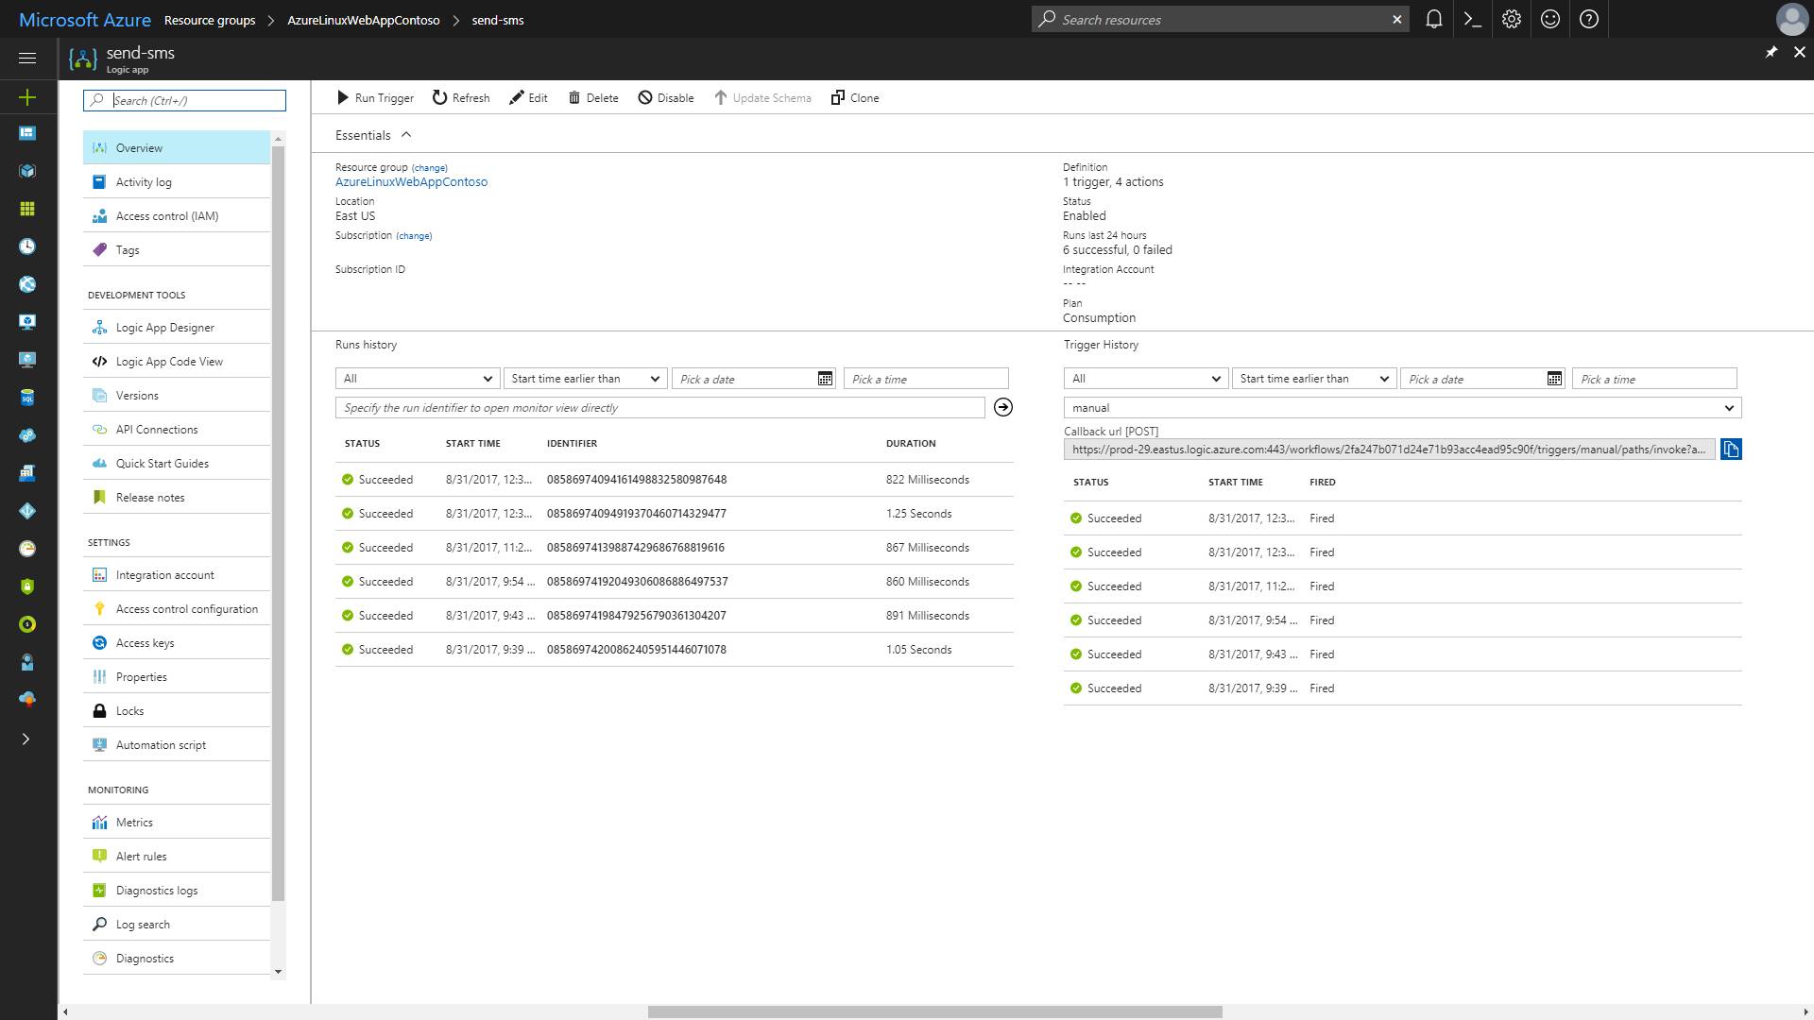
Notes:
1. Click Edit

Slide 60
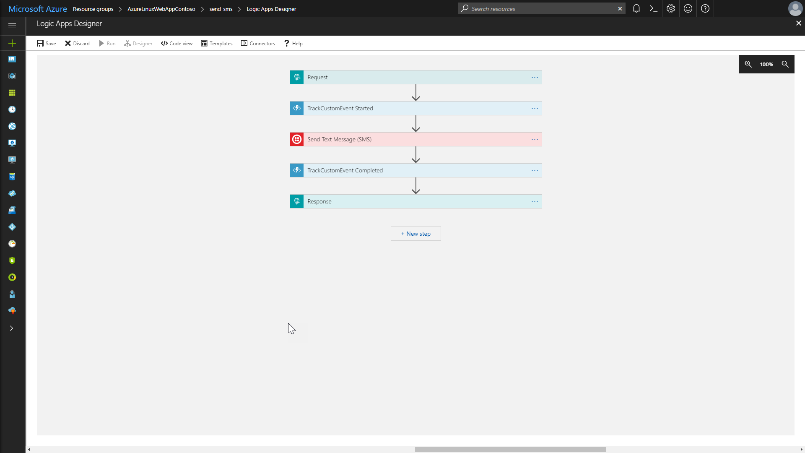
Notes:
1. Click the Send Text Message (SMS) step

Slide 61
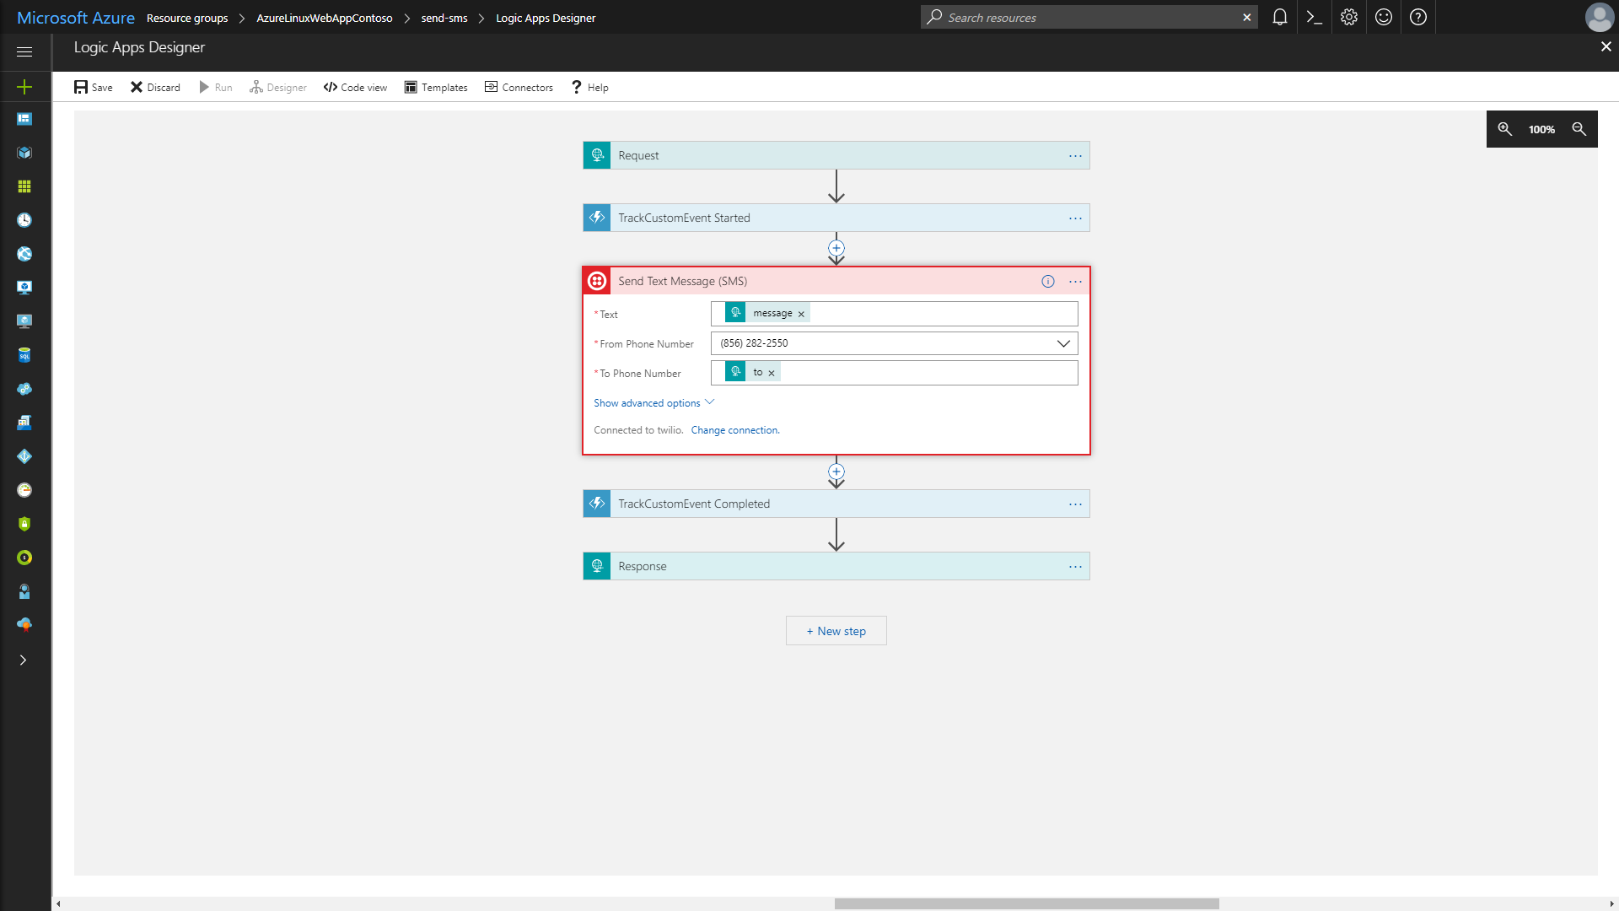
Notes:
Show the details in the Send Text Message (SMS) step
Click the Resource Group in the breadcrumb at the top of the page

Slide 62
Notes:
1. Click the Azure Function

Slide 63
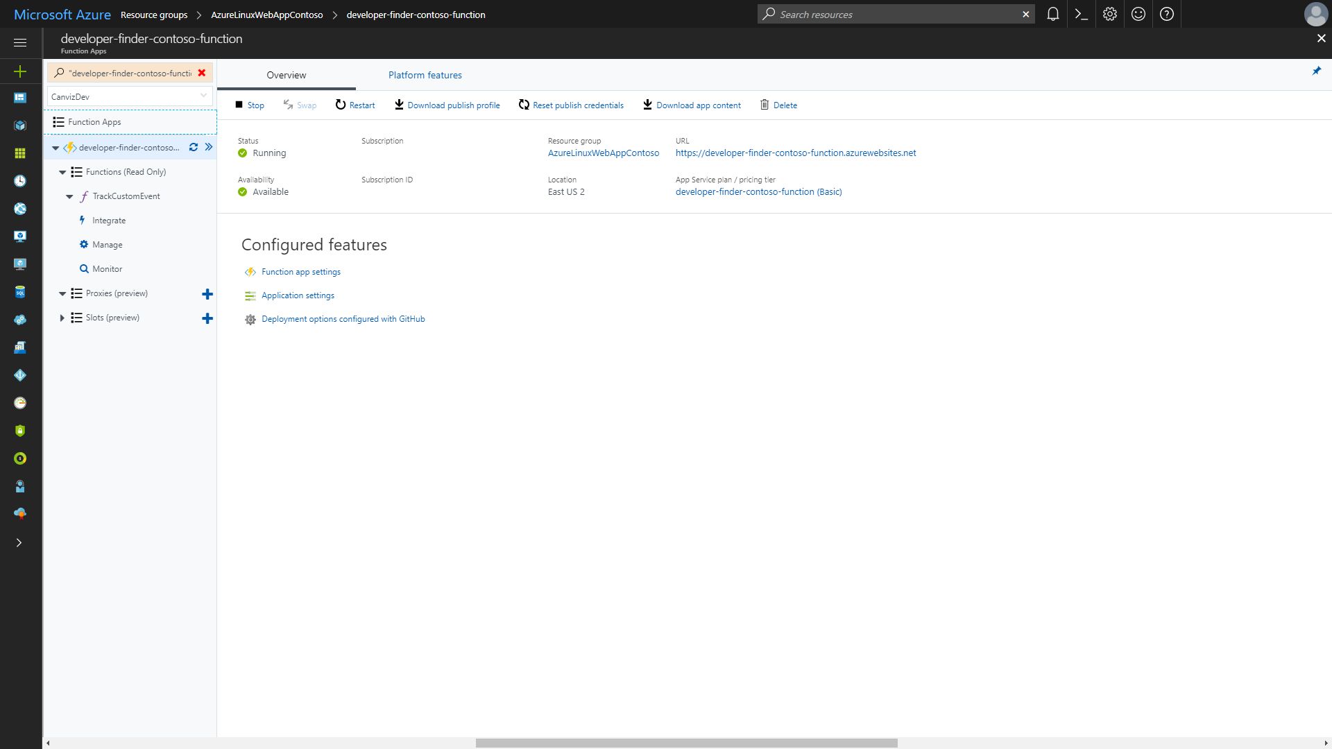
Notes:
1. Click TrackCustomEvent

Slide 64
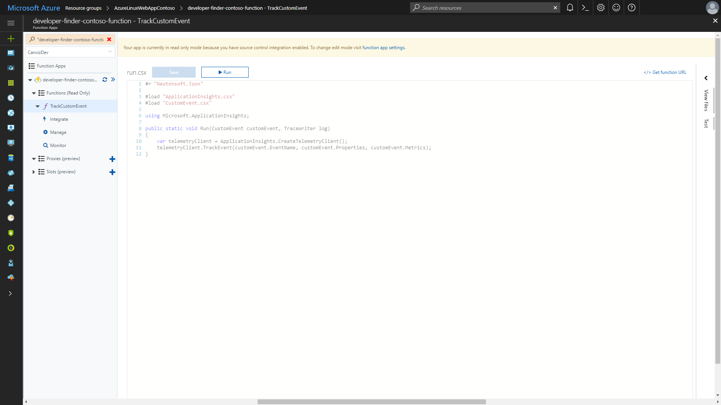
Notes:
1. View the code in the TrackCustomEvent Azure Function that creates Custom Events in Application Insights

Slide 65
Reset Demo User Accounts
Resetting a demo user’s account does the following things.
Deletes all the data in the database for the demo
Allows you to log in with the user again and do any demo steps entirely from scratch
See the following slides to see how to reset a user account

Slide 66
Notes:
1. Open the dropdown menu in the top right corner

Slide 67
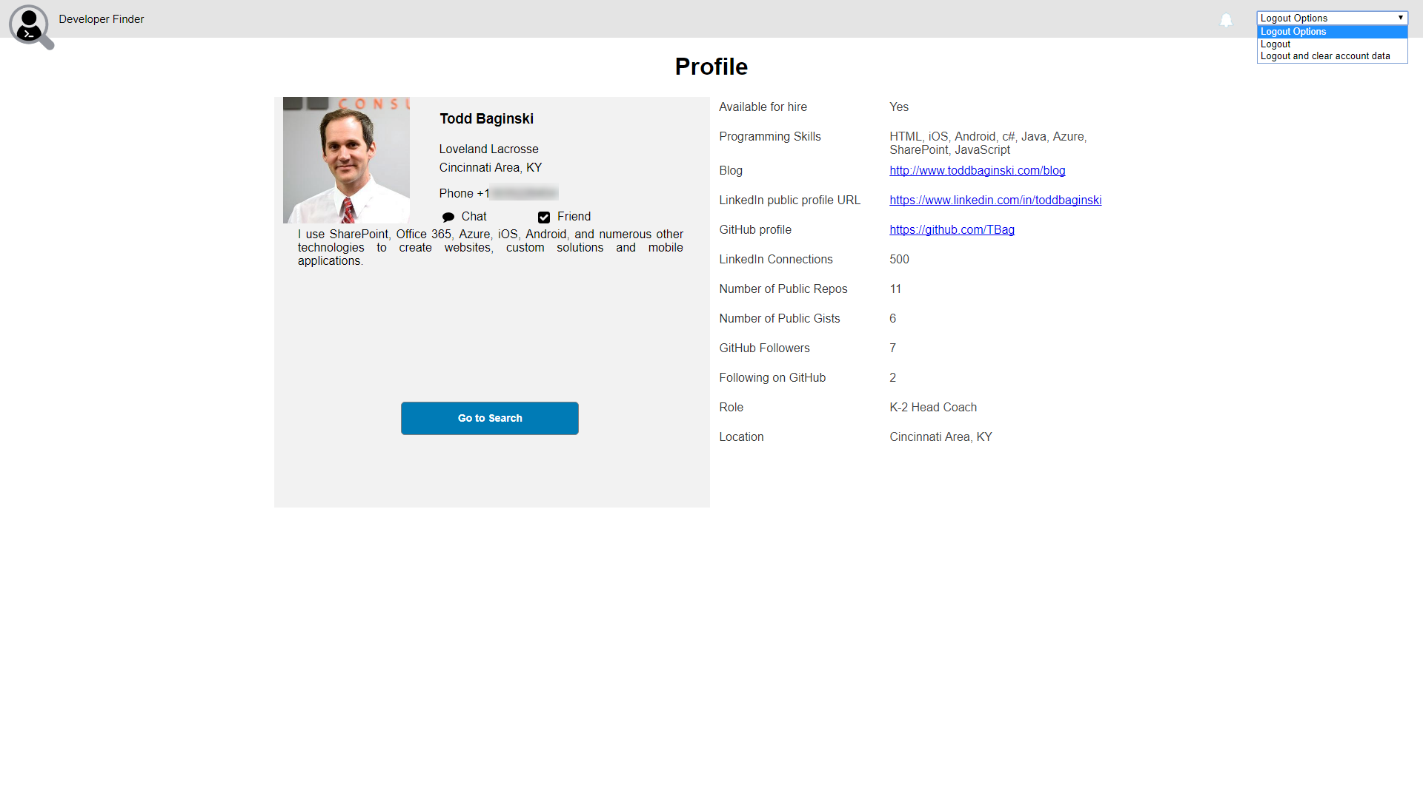
Notes:
1. Select Logout and clear account data

